Slide 1
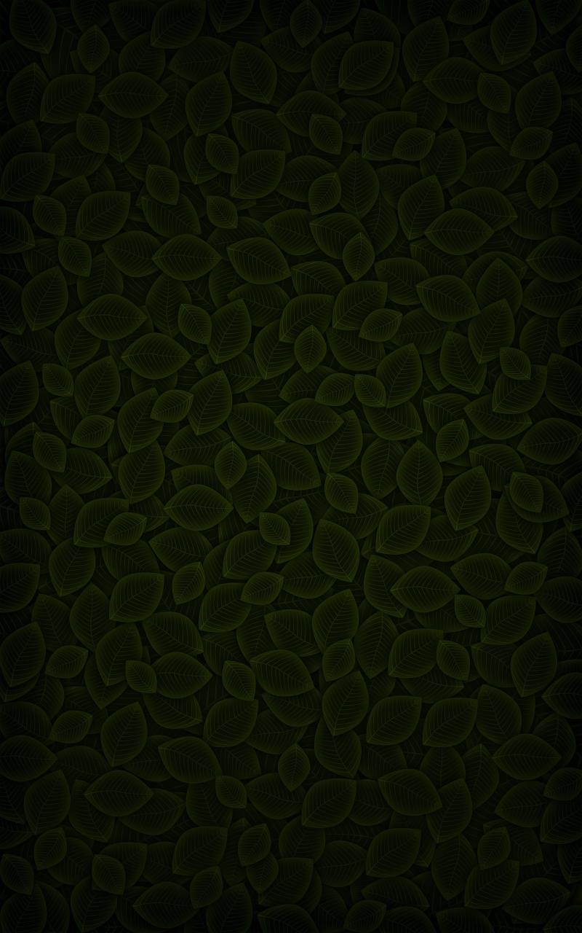


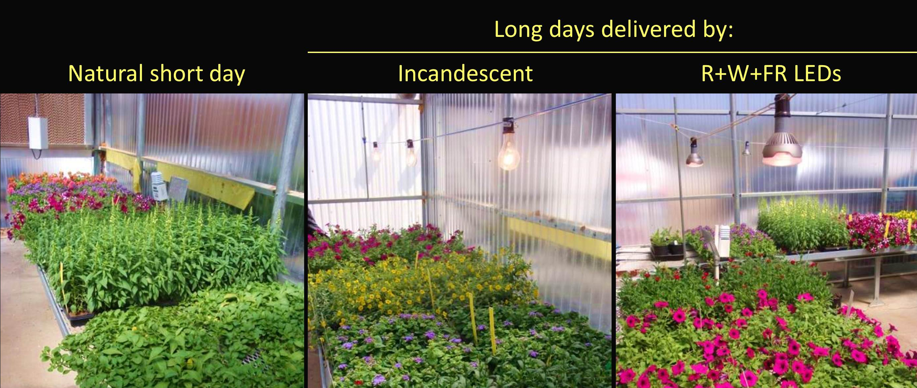
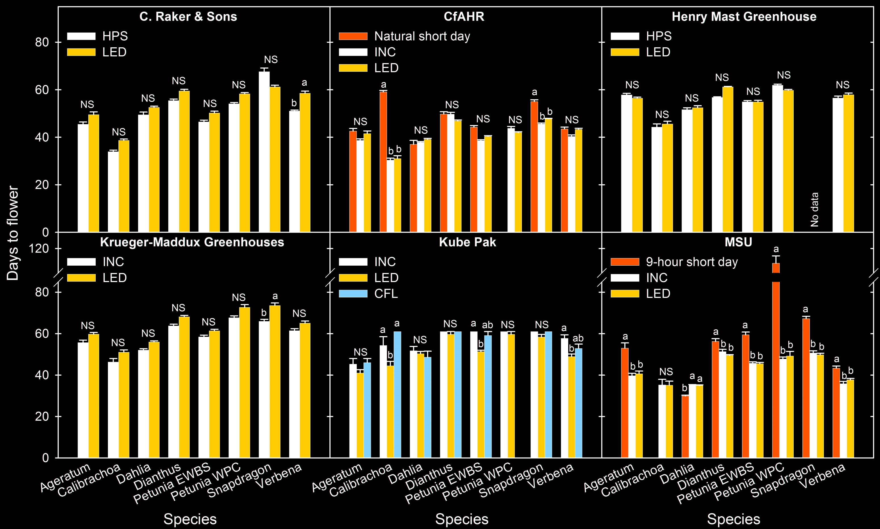
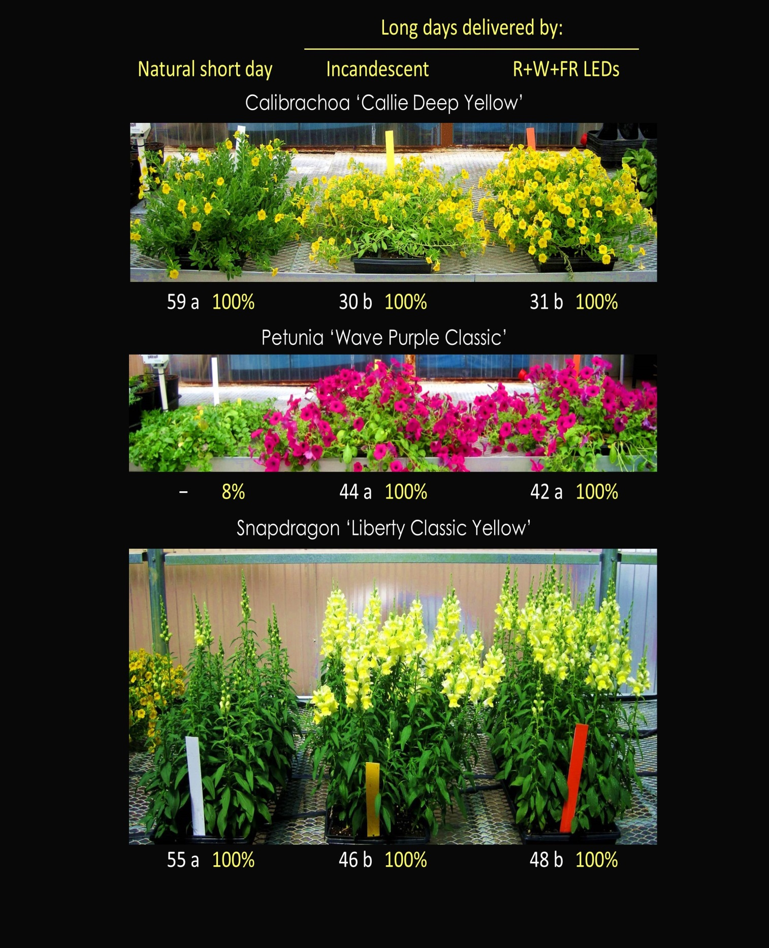
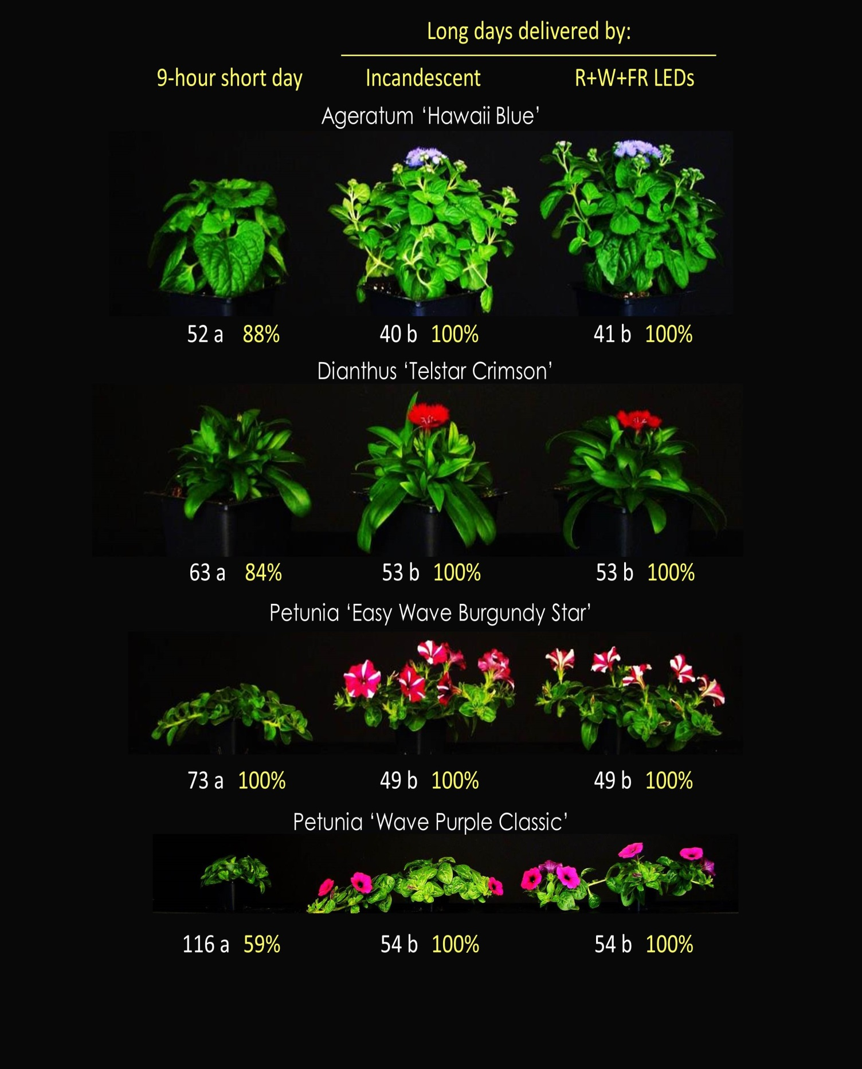
Controlling Flowering of Photoperiodic Ornamental Crops Using
Light-emitting Diode Lamps: A Coordinated Grower Trial
Qingwu Meng¹ and Erik S. Runkle²
Department of Horticulture, Michigan State University, East Lansing, MI, USA
Introduction
Night-interruption (NI) lighting from lamps with a moderate ratio of red (R, 600 to 700 nm) to far-red (FR, 700 to 800 nm) light effectively promotes flowering of a wide range of long-day plants (Craig and Runkle, 2012). Due to spectral controllability, long life span, and energy efficiency, light-emitting diodes (LEDs) have emerged as an alternative to conventional light sources, such as incandescent (INC, R:FR = 0.56) and high-pressure sodium (HPS, R:FR = 4.7) lamps. A new 14-W R + white (W) + FR LED lamp (R:FR = 0.82) was developed as a commercial replacement for 100- to 150-W INC lamps used for photoperiodic lighting. We performed and coordinated a commercial greenhouse grower trial to determine whether the R+W+FR LED lamp was as effective as conventional lamp types used to regulate flowering.
Hypothesis
We postulated that the R+W+FR LED lamps would be at least as effective as conventional lamp types in flowering applications.
Materials and Methods
Plant Material. Ageratum (Ageratum houstonianum) ‘Hawaii Blue’, calibrachoa (Calibrachoa ×hybrida) ‘Callie Deep Yellow’, dahlia (Dahlia ×hybrida) ‘Dahlinova Texas’, dianthus (Dianthus chinensis) ‘Telstar Crimson’, petunia (Petunia ×hybrida) ‘Easy Wave Burgundy Star’ (EWBS) and ‘Wave Purple Classic’ (WPC), snapdragon (Antirrhinum majus) ‘Liberty Classic Yellow’, and verbena (Verbena ×hybrida) ‘Obsession’ were shipped to all companies as young seedlings or liners.
Trial Sites. C. Raker & Sons (Litchfield, MI), the Center for Applied Horticultural Research (CfAHR) at Altman Plants (Vista, CA), Henry Mast Greenhouse (Byron Center, MI), Krueger-Maddux Greenhouses (Sunman, IN), Kube Pak (Allentown, NJ), and two replicate greenhouses at Michigan State University (MSU, East Lansing, MI).
Lighting Treatments. All sites delivered 4-hour NI lighting treatments from R+W+FR LEDs (Philips) and a conventional lamp type (e.g., INC or HPS lamps). CfAHR also delivered a natural short day (Fig. 1), MSU a truncated 9-hour short day, and Kube Pak a 4-hour NI treatment from compact fluorescent (CFL) lamps.
Data Collection. Days from transplant to first open flower were recorded. Additional data (e.g., plant height and visible bud/inflorescence number at flowering) were recorded for the treatments at MSU.
Data Analysis. Data were analyzed using SAS v.9.3 with PROC GLIMMIX, and pairwise comparisons were performed using Tukey’s HSD test (P = 0.05).
Fig. 1. Setup of photoperiod treatments at the Center for Applied Horticultural Research.
Fig. 2. Days to flower at six trial sites. Here and in Fig. 3 and 4, values with different letters within species are significantly different (P ≤ 0.05). CFL, compact fluorescent. HPS, high-pressure sodium. INC, incandescent. LED, light-emitting diode. Data at MSU were from one greenhouse.
Fig. 3. Days to flower (in white) and flowering percentage (in yellow) at the Center for Applied Horticultural Research. –, insufficient data.
Fig. 4. Days to flower (in white) and flowering percentage (in yellow) at MSU. Data were pooled from two replicate greenhouses.
Results
C. Raker & Sons. There was no significant impact of lamp type on flowering time for any crop except for verbena, which flowered eight days earlier under the HPS lamps than under the LEDs (Fig. 2).
CfAHR. All crops under the INC lamps and LEDs flowered at approximately the same time, whereas some crops did not flower under natural short days. Calibrachoa and snapdragon flowered approximately four or one week(s) earlier under the NI lighting treatments than under short days, respectively (Fig. 3).
Henry Mast Greenhouse. All plants flowered similarly under the HPS lamps and LEDs except for snapdragon, in which only 8% flowered under the HPS lamps when the trial ended.
Krueger-Maddux Greenhouses. All plants flowered similarly under the INC lamps and LEDs except snapdragon, which flowered eight days earlier under the INC lamps than under the LEDs.
Kube Pak. Petunia WPC did not flower under the CFL lamps when the trial ended. Calibrachoa, petunia EWBS and verbena flowered earlier under the LEDs than under the INC lamps.
MSU. Ageratum, dianthus, petunia EWBS and WPC, and snapdragon flowered similarly under the INC lamps and LEDs, and earlier than under short days (Fig. 4). Except for dahlia and petunia WPC, plant height and visible bud/inflorescence number at flowering was similar under the INC lamps and LEDs.
Conclusions
In most instances, the R+W+FR LEDs were as effective at controlling flowering as lamps traditionally used in commercial greenhouses. Given the comparable effectiveness of the LEDs and conventional lamps, factors such as energy availability and consumption, lamp longevity, purchase price, lamp operation, and availability of energy rebates could be considered to calculate whether a return on investment of the LEDs is favorable.
Reference
Craig, D.S. and E.S. Runkle. 2012. Using LEDs to quantify the effect of the red to far-red ratio of night-interruption lighting on flowering of photoperiodic crops. Acta Hort. 956:179−186.
Acknowledgements
The authors thank the participating companies for their cooperation with this project. They also thank Philips Lighting and HortAmericas for subsidizing the cost of the LEDs and funding provided by the USDA National Institute of Food and Agriculture’s Specialty Crop Research Initiative and MSU’s Project GREEEN.
Contact Information
¹E-mail: mengqin1@msu.edu. ²E-mail: runkleer@msu.edu.

