Slide 1


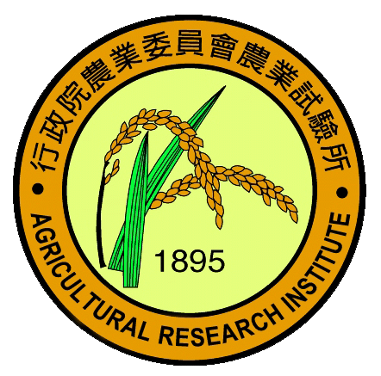
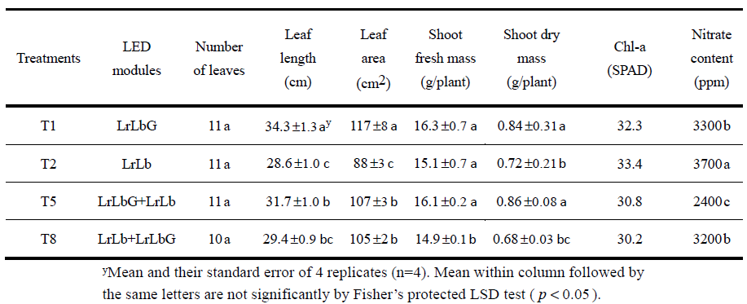
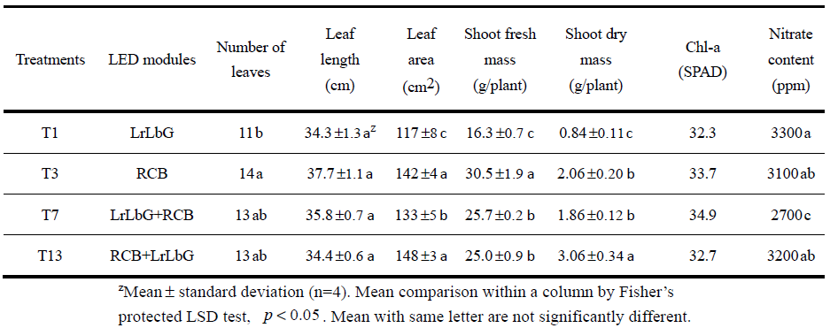
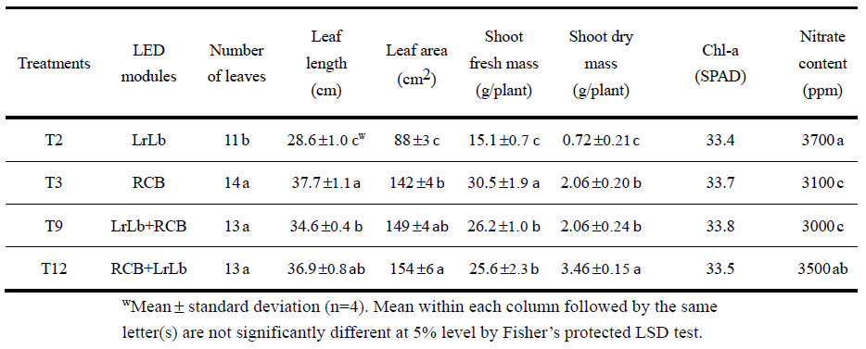
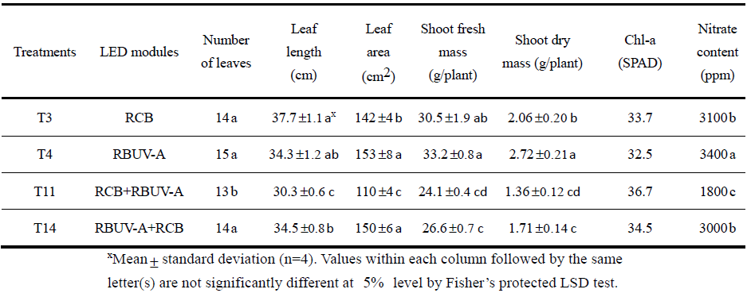
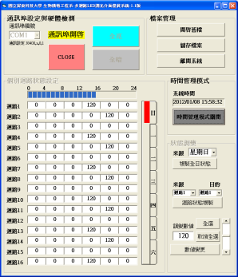
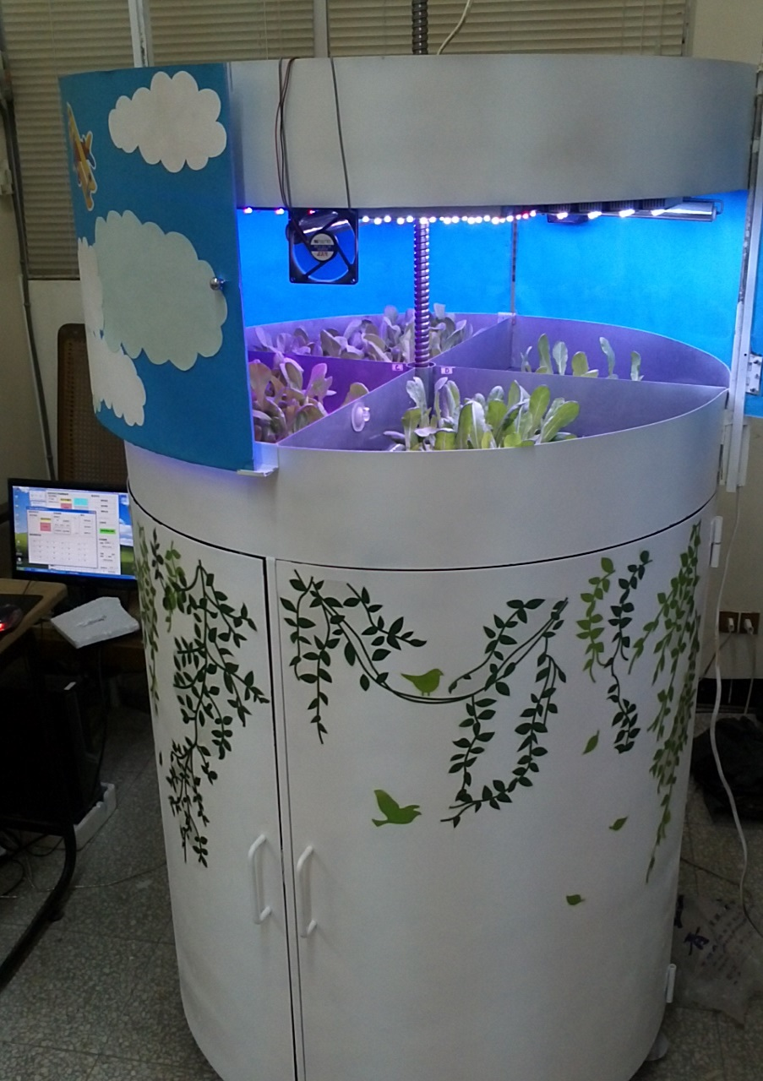
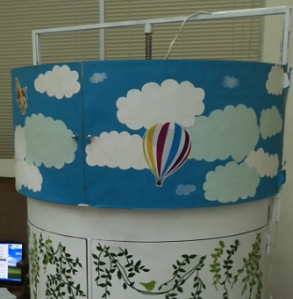
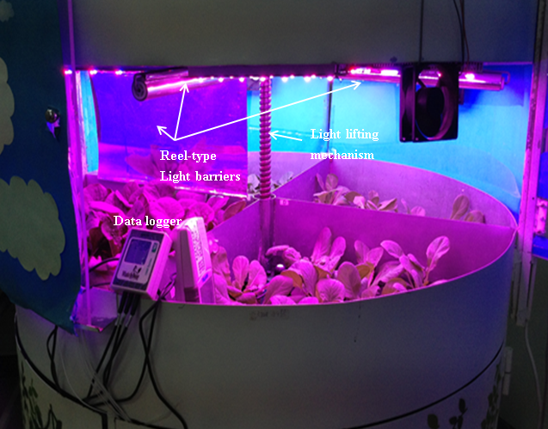
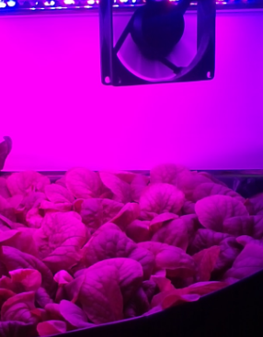
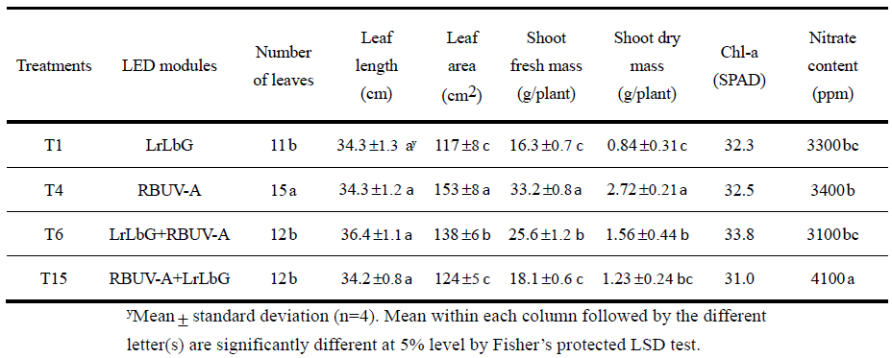
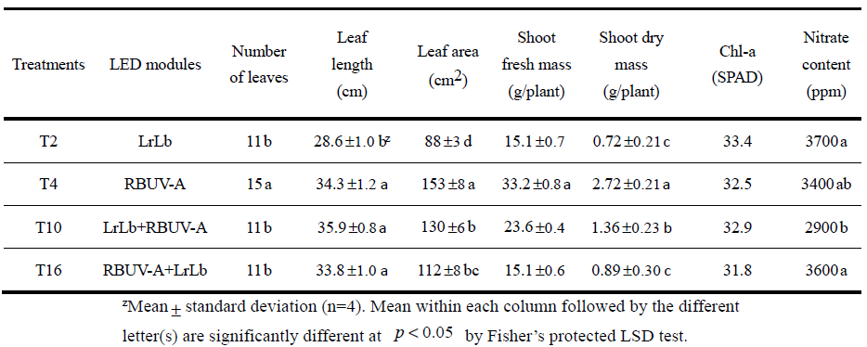
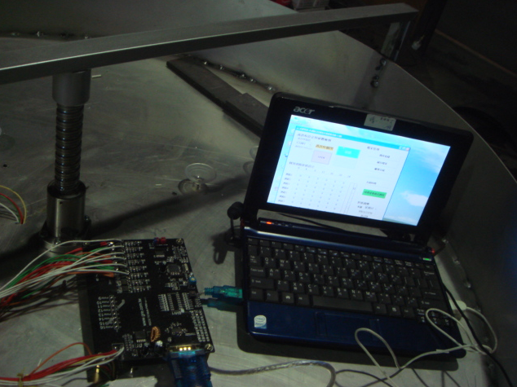
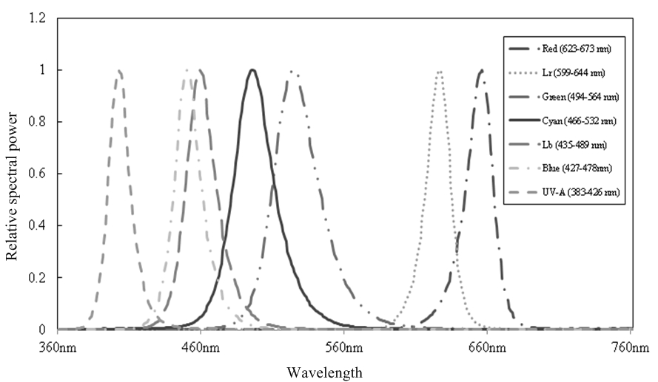
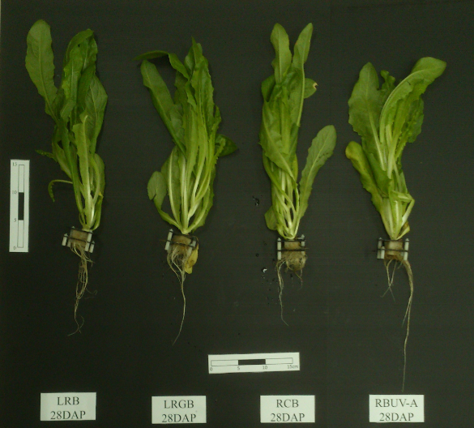
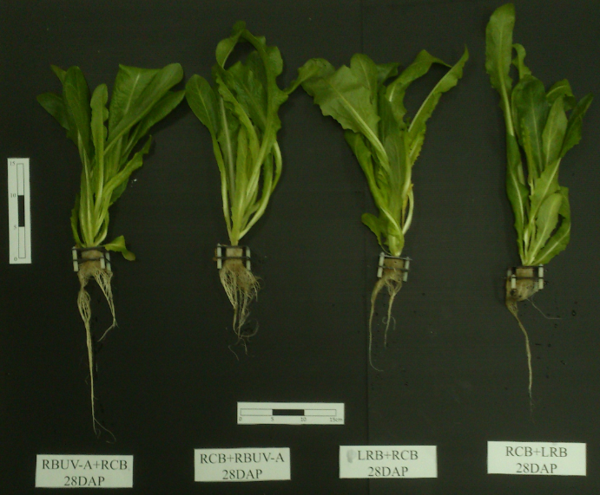
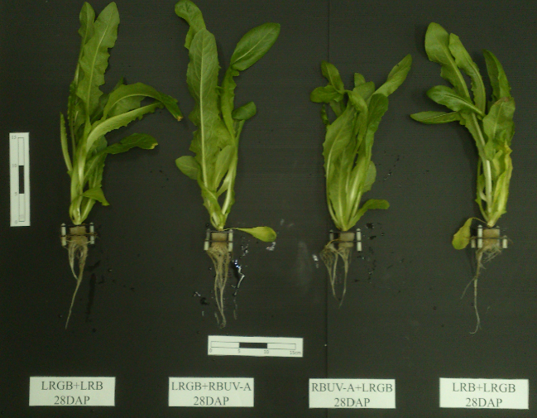
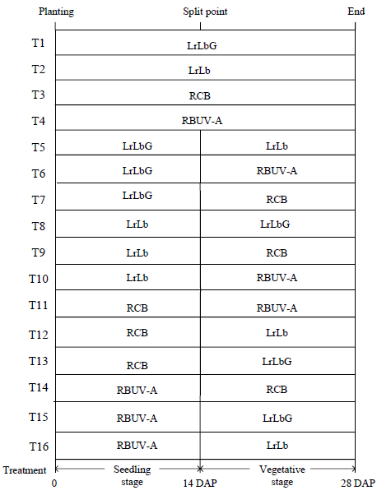
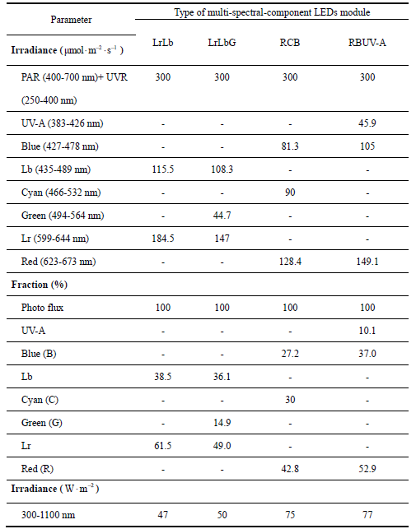
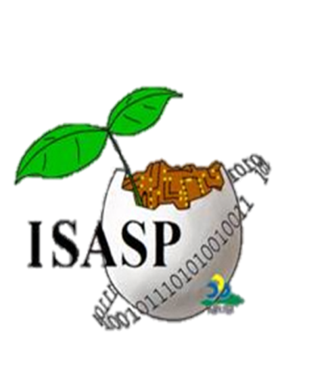


2014 ASHS Annual Conference, 28-31 July 2014, Orlando, Florida, USA
The Effect of Multi-wavelength Light-emitting Diode Lighting on the Growth Response of Leaf Lettuce at Different Stages
Chung-Liang Chang*, Kuang-Pi Chang
Department of Biomechatronics Engineering, National Pingtung University of Science and Technology,
*Corresponding Author-- Voice: +886-8-7703202 Ext. 7586/7718,
Email: chungliang@mail.npust.edu.tw
HIGHLIGHT
RESULTS & DISCUSSION
Four type of multi-spectral-component LEDs are conducted on leaf lettuce at seedling- and vegetative stage.
Different growth stage given different multi-spectral-component LEDs results in a tremendous difference in nitrate.
The higher, the chlorophyll, the lower the nitrate content among LED lighting treatments.
Different cultivation stage given different LED sets results in a tremendous difference in nitrate.
The relationship analysis of chl a in contrast to nitrate using SPAD-502 shows that the higher, the chl a, the lower the nitrate among sixteen treatments.
Using different LED sets results in a tremendous difference in plant quality.
LrLbG or LrLb with other combinations results in the worst quality of plant
The nitrate 1800 ppm in RCB+RBUV-A is the lowest, whereas the nitrate 4100 ppm in RBUV-A+LrLbG is the highest, which exceeds the EU standard of lettuce grown in the open air, but is lower than the 4500 ppm standard of lettuce grown under cover
MOTIVATION AND OBJECTIVE
Different types of light source selection and control is an important technique in crop production system (AVRDC, 1990; Adams, 1990).
It is necessary to provide the light supplementary technique and select a good combination of light qualities for plant growth, which results in the efficiency of photosynthesis for plant.
The lighting period, light qualities, light intensity, and light quantity are mostly important factor, which affects the plant growth.
The LED dimming system is developed and implemented via microcontroller, graphic user interface (GUI), and multi-wavelength LED module for use in to greenhouse.
The user can setup the LED lighting plans via GUI written in Visual Basic software.
MATERIALS AND METHODS
LED drive module (PIC16F887 microcontroller, PWM, and power supply)
Thee graphic user interface (GUI) is designed by utilizing Visual BASIC (VB) language.
The LED lighting parameter management: To record and store the experiment parameters into hard disk through the software interface.
Sixteen LED Lighting Treatments
Light Parameters of Different LED Sets
CONCLUSIONS
RB formed the primary combination to which a single light supplementation is added but the proportion of red light remained high.
Instead of further adding LED of different wavelength to influence plant growth, finer segmentation of plant growth stages could be considered.
In each stage, combination of three different light wavelengths could be applied to benefit plants and concurrently reduce energy wastage.
In the future, the ultra-violet lights (UV-A, UV-B) and ultra-red light served as light supplementation to plants in different growth stages.
ACKNOWLEDGEMENTS
This project has been supported under grant Ministry of Science and Technology (NSC 102-2622-E-020-006-CC3) and Agriculture Council of Taiwan (103 AS-14.4.1-ST-a5)
http://www.isasp-biome.npust.edu.tw/

