Slide 1


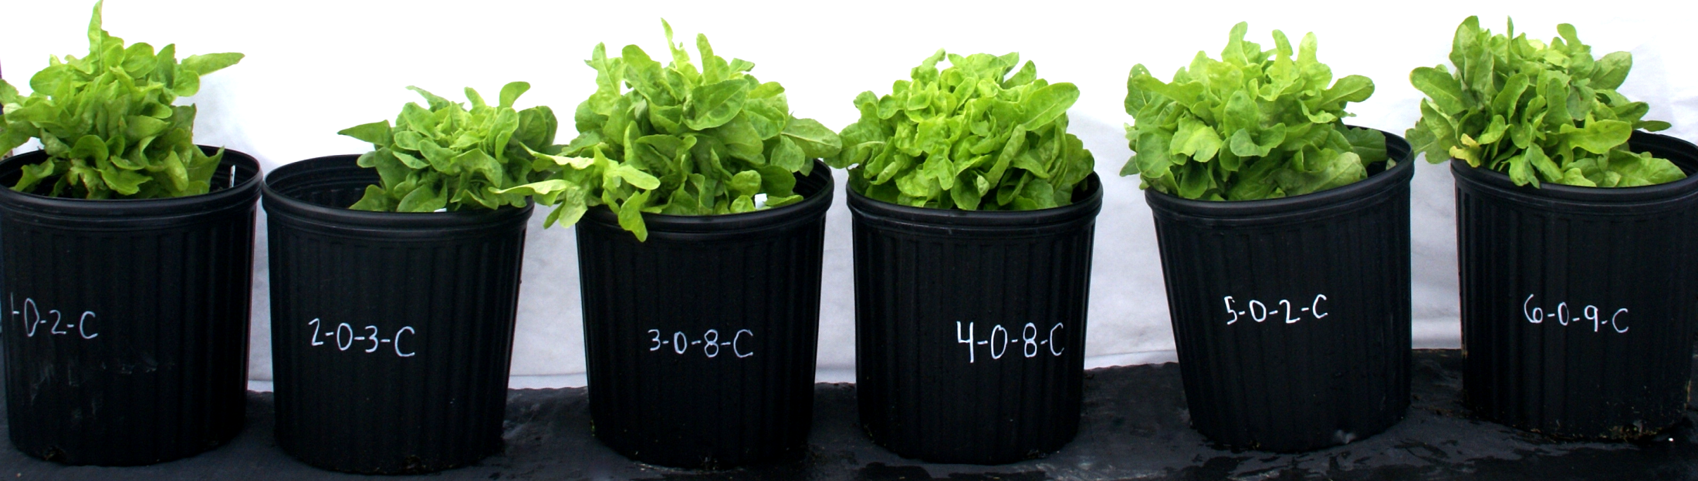
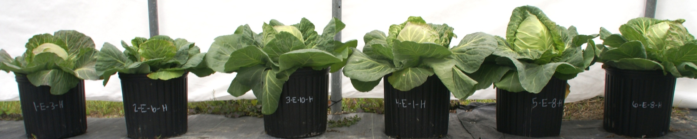
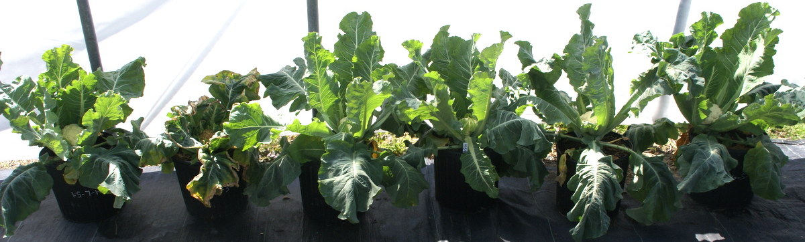
Calcium and Magnesium Sources and Rates in Potting Media for Vegetable Production with Alkaline Irrigation
Kathryn Fontenot¹, Sarah Bertrand², Edward Bush³, Charles Johnson⁴
¹Assistant Professor, ² Graduate Student, ³Associate Professor, ⁴ Professor
School of Plant, Environmental and Soil Sciences, 155 JC Miller Hall, Baton Rouge, La 70803
ABSTRACT
Fall Crops
Lettuce | Lactuca sativa ‘Oakleaf’
Cabbage | Brassica oleracea var. capitata ‘Earliana’
Cauliflower | Brassica oleracea var. botrytis ‘SnowCrown’
Media treatment Ca/Mg and 4L+Ca/Mg produced significantly greater yields of cabbage than the IS or C treatments. Media treatments Ca/Mg, 4L, and 4L+Ca/Mg had significantly greater cabbage dry weights than the IS and C (Table 4).
Home gardeners in areas with alkaline water sources do not have means of acidifying water for vegetable production. A solution to achieving optimal yields with alkaline irrigation water is to use specialized media; however, current media available does not meet these needs. Media recipes with varied levels (0 to 8 lbs/yd³) and sources of Ca (dolomitic lime, calcium sulfate) and Mg (dolomitic lime, magnesium sulfate) were tested using alkaline irrigation on lettuce, cabbage, and cauliflower crops under high tunnel and on nursery yard sites. Media treatments with an 80:20 bark:peat and 7.1 kg/m³ slow release 15-9-11 base mix and the following fertilizer levels: 2.4 kg/yd³ calcium sulfate and 2.4 kg/yd³ magnesium sulfate (Ca/Mg); 2.4 kg/yd³ dolomitic lime (4L); 2.4 kg/yd³ dolomitic lime, 2.4 kg/yd³ calcium sulfate, and 2.4 kg/yd³ magnesium sulfate (4L+Ca/Mg); 4.7 kg/yd³ dolomitic lime (8L), outperformed a commercially available (IS) and control (C) (no Ca or Mg fertilizer) media in nearly all crops. All crops grown on the nursery yard and cabbage grown under the high tunnel had significantly greater yields when grown in medium 4L+Ca/Mg, compared to the IS and C media (p≤0.05). Media treatment 4L produced significantly greater yields and plant growth of all tested crops on the nursery yard compared to the IS and C media (p≤0.05).
Trt | Abbreviation | Base Mix | Fertilizer Added
1 | IS | Popular home gardener potting mix | None
2 | C | 80:20 bark:peat + 7.1 kg slow release (15-9-11) | None
3 | Ca/Mg | 80:20 bark:peat + 7.1 kg slow release (15-9-11) | 2.4 kg calcium sulfate + 2.4 kg magnesium sulfate
4 | 4L | 80:20 bark:peat + 7.1 kg slow release (15-9-11) | 2.4 kg dolomitic lime
5 | 4L+Ca/Mg | 80:20 bark:peat + 7.1 kg slow release (15-9-11) | 2.4 kg dolomitic lime + 2.4kg calcium sulfate + 2.4 kg magnesium sulfate
6 | 8L | 80:20 bark:peat + 7.1 kg slow release (15-9-11) | 4.7 kg dolomitic lime
Table 4. Lettuce, cabbage, and cauliflower yield at harvest when produced under a high tunnel with Ca and Mg amended organic media and alkaline irrigation for two planting dates.
Planting Date 1
 | Lettuce |  | Cabbage |  | Cauliflower
Treatment^{Z} | Fresh Weight | Dry Weight | Fresh Weight | Dry Weight | Fresh Weight | Dry Weight
 | ▪▪▪▪g▪▪▪▪ | ▪▪▪▪g▪▪▪▪ | ▪▪▪▪g▪▪▪▪ | ▪▪▪▪g▪▪▪▪ | ▪▪▪▪g▪▪▪▪ | ▪▪▪▪g▪▪▪▪
IS | 204 b^{w} | 8.6 b | 697.4 c | 33.8 b | 382.0 b | 29.7 ab
C | 153 c | 8.1 b | 490.2 d | 23.2 c | 53.3 c | 4.4 c
Ca/Mg | 265 a | 11.3 a | 951.5 b | 47.4 a | 416.8 ab | 28.3 b
4L | 215 ab | 9.3 ab | 833.5 bc | 43.0 a | 426.2 ab | 32.4 ab
4L+Ca/Mg | 228 ab | 10.4 ab | 1173.6 a | 48.1 a | 534.0 a | 38.5 a
8L | 234 ab | 10.1 ab | 882.8 bc | 41.9 ab | 420.3 ab | 28.7 b
Planting Date 2
 | Lettuce |  | Cabbage |  | Cauliflower
Treatment | Fresh Weight | Dry Weight | Fresh Weight | Dry Weight | Fresh Weight | Dry Weight
 | ▪▪▪▪g▪▪▪▪ | ▪▪▪▪g▪▪▪▪ | ▪▪▪▪g▪▪▪▪ | ▪▪▪▪g▪▪▪▪ | ▪▪▪▪g▪▪▪▪ | ▪▪▪▪g▪▪▪▪
IS | 200 c | 8.7 bc | 320.4 b | 20.3 b | 205.4 bc | 13.7 bc
C | 106 d | 5.3 d | 258.7 b | 19.9 b | 93.8 c | 5.8 c
Ca/Mg | 196 c | 7.9 c | 544.8 a | 35.7 a | 352.7 a | 22.7 a
4L | 251 ab | 10.0 ab | 642.4 a | 36.5 a | 358.9 a | 24.2 a
4L+Ca/Mg | 226 bc | 10.1 ab | 647.9 a | 36.8 a | 299.6 ab | 17.4 ab
8L | 276 a | 10.7 a | 574.3 a | 36.2 a | 371.8 a | 23.3 a
INTRODUCTION
There is a lack of prepackaged media suitable for the container production of vegetable crops. As a result, most home gardeners use prepackaged medias developed to produce annual flowers. Advanced vegetable gardeners mix their own media, most commonly (in the southeastern United States) using pine bark, peat and fertilizer. Lime is often incorporated to increase the media pH range from 5.5 - 6.4 for most vegetable crops (Argo, 1996). The lack of available media combined with high pH irrigation water is detrimental to many home vegetable gardeners. Thus far, university-based experiments have not reported liming rates specific to container vegetable production. This experiment seeks to develop a specialized media suitable for container production of lettuce, cabbage, and cauliflower irrigated with alkaline water.
RESULTS
Media treatment 4L and 4L+Ca/Mg produced significantly more edible biomass (fresh weight) compared to the C and IS media for all crops grown on the nursery yard. Dry weight of cauliflower grown in media treatments 4L+Ca/Mg and 8L were also greater than the IS and C media. (Table 3).
^{W}Means within columns (within planting date) followed by the same letter are not significantly different according to Duncan’s Multiple Range Test (P≤0.05).
Table 3. Lettuce, cabbage, and cauliflower yield at harvest when produced on a nursery yard with Ca and Mg amended organic media and alkaline irrigation for two planting dates.
CONCLUSIONS
MATERIALS & METHODS
Media treatment 4L and 4L+Ca/Mg produced the greatest fresh weights of the edible portions (yield) of all three crops compared to the IS and C on the nursery yard. Under the high tunnel, 4L+Ca/Mg produced the greatest head fresh weights for cabbage. Further research is warranted using additional crops grown in these two medias to determine if these recipes are suitable for optimal growth of all vegetables in home garden container production.
Experimental Design. Two experimental sites were established, a nursery yard arranged in a randomized block design with overhead irrigation (2.5 gal/min), exposed to rain water, and a high tunnel arranged in a randomized block design with drip irrigation (2 gal/h) not exposed to rain water. Crops were grown in six media treatments. Each medium treatment/crop combination was replicated ten times per experimental site, and each planting was replicated over two planting dates, approximately two months apart. Containers were watered twice daily at 10 minute increments and fertilized with liquid fertilizer (24-8-16) once during the season (1 tablespoon per gallon per container). Fresh weight (g) of the entire plant (cut even with soil line) was measured. Cabbage and cauliflower heads –only were also measured separate from the entire plant mass. Dry head and foliage weights were recorded.
Planting Date 1
 | Lettuce |  | Cabbage |  | Cauliflower
Treatment^{Z} | Fresh Weight | Dry Weight | Fresh Weight | Dry Weight | Fresh Weight | Dry Weight
 | ▪▪▪▪g▪▪▪▪ | ▪▪▪▪g▪▪▪▪ | ▪▪▪▪g▪▪▪▪ | ▪▪▪▪g▪▪▪▪ | ▪▪▪▪g▪▪▪▪ | ▪▪▪▪g▪▪▪▪
IS | 137 b^{w} | 6.4 a | 243.9 bc | 20.3 ab | 209.7 c | 22.2 b
C | 140 b | 6.6 a | 204.2 c | 12.1 b | 73.9 d | 6.4 c
Ca/Mg | 191 a | 7.9 a | 456.1 ab | 30.1 a | 277.3 bc | 24.8 b
4L | 206 a | 8.8 a | 530.4 a | 32.1 a | 358.7 ab | 28.1 ab
4L+Ca/Mg | 220 a | 8.5 a | 524.9 a | 30.2 a | 380.3 ab | 36.1 a
8L | 199 a | 8.3 a | 613.4 a | 31.5 a | 412.8 a | 35.1 a
Planting Date 2
 | Lettuce |  | Cabbage |  | Cauliflower
Treatment | Fresh Weight | Dry Weight | Fresh Weight | Dry Weight | Fresh Weight | Dry Weight
 | ▪▪▪▪g▪▪▪▪ | ▪▪▪▪g▪▪▪▪ | ▪▪▪▪g▪▪▪▪ | ▪▪▪▪g▪▪▪▪ | ▪▪▪▪g▪▪▪▪ | ▪▪▪▪g▪▪▪▪
IS | 316 b | 12.4 a | 277.6 c | 25.6 c | 173.5 c | 14.4 c
C | 155 d | 8.0 b | 106.1 d | 13.0 d | 93.6 c | 7.3 c
Ca/Mg | 251 c | 8.9 b | 414.3 bc | 27.1 c | 276.8 b | 24.3 b
4L | 371 a | 13.5 a | 455.9 ab | 34.9 ab | 289.0 b | 23.5 b
4L+Ca/Mg | 374 a | 12.6 a | 609.5 a | 38.8 a | 437.2 a | 32.3 a
8L | 364 ab | 11.9 a | 529.9 ab | 30.4 bc | 355.2 ab | 22.8 b
LITERATURE CITED
Argo, W.R. and J.A. Biernbaum. 1996. The effect of lime, irrigation water source, and water-soluble fertilizer on root-zone pH, electrical conductivity, and macronutrient management of container root medium with impatiens. J.Amer.Soc.Hort.Sci. 121(3):442-452.
^{W}Means within columns (within planting date) followed by the same letter are not significantly different according to Duncan’s Multiple Range Test (P≤0.05).
IS
C
Ca/Mg
4L
4L+Ca/Mg
8L
IS
C
Ca/Mg
4L
4L+Ca/Mg
8L
IS
C
Ca/Mg
4L
4L+Ca/Mg
8L

