Slide 1

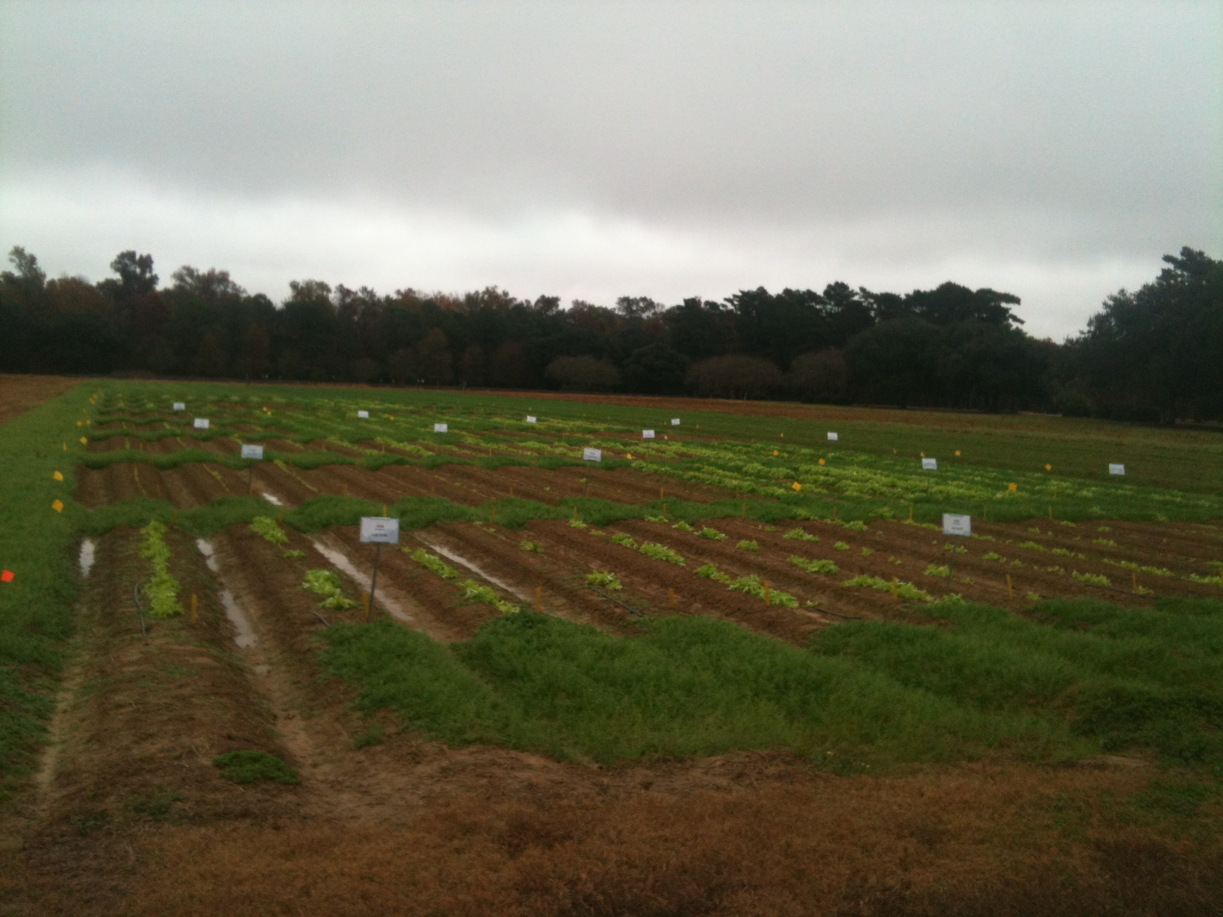
An Investigation of Weed Suppression Using Various Pre-Emergent Herbicide Treatments on a Direct-Seeded, Field-Grown Leaf Lettuce Crop
Kathryn K. Fontenot¹, Ron E. Strahan², Tara P. Smith^{2*}, Charles E. Johnson³ Robert Williams⁴, Mavis Finger^{4*}
¹Assistant Professor, ²Associate Professor, ³Professor, ⁴Extension Associates
School of Plant, Environmental and Soil Sciences 155 JC Miller Hall Baton Rouge, La 70803 *Sweet Potato Research Station 130 Sweet Potato Road, Chase, La 71324
Abstract
Table 1. Percent Control of Annual Bluegrass and Swinecress in Direct Seed Lettuce Fields with Varying Rates of Pre-emergent Herbicides
Commercial lettuce producers struggle with weed control in direct-seeded fields. Pre-emergent herbicides with the ability to control weeds without injuring the crop would be beneficial to producers. In this study, ‘Green Salad Bowl’ leaf lettuce was seeded into plots arranged in a randomized complete block with 4 replications three days prior to pre-emergent herbicide application. Precision single row push seeders were used to direct seed the crop. Plot size was 4 rows totaling 16 ft x 20 ft. The 2 center rows were used to collect data. Eight treatments were evaluated for their potential weed control without suppression of lettuce growth. Treatments included: Pronamide at 1lb/A and 2lb/A rates. Pronamide is currently labeled for use in leaf lettuce production. Non-labeled herbicides were also evaluated, including Imazapic at 2oz/A, 4oz/A and 6oz/A rates and Imazethapyr at 6 fluid oz/A rate. An untreated weed-free check was maintained by weekly cultivation and an untreated check receiving no cultivation served as a control treatment. Herbicides were sprayed at the listed rates with a CO₂ backpack sprayer delivering 15 GPA. Throughout the 78d study, lettuce germination rates and heights were recorded. Final lettuce fresh and dry weight was collected and statistically analyzed. Data were subjected to analysis of variance (P=0.05) and means were separated using Fisher’s LSD. Plots treated with Pronamide at the 1lb/A rate and 2lb/A rate and the untreated weed-free check produced significantly more fresh and dry tissue weight than all other treatments. Although lettuce germinated and grew in the Imazapic and Imazethapyr treated plots, growth was severely stunted. Preliminary results suggest that Imazapic and Imazethapyr not be considered for pre-emergent weed control in direct seeded leaf lettuce as weed control was sufficient but lettuce growth was severely stunted. Additional research in a second season is warranted.
HERBICIDE | RATE
Kerb | 1 LB AI/A
Kerb | 2 LB AI/A
Plateau | 2 OZ/A
Plateau | 4 OZ/A
Plateau | 6 OZ/A
Pursuit | 6 FL OZ/A
Untreated Weed-Free Check
Untreated Check
B
A
C
AB
A
A
A
A
A
BC
AB
AB
D
C
Introduction
E
D
Lettuce variety trials were conducted at LSU AgCenter Botanic Gardens in the fall of both 2012 and 2013 (data not yet published). Fruit and Vegetable Producers throughout Louisiana were invited to attend a field day to present information gathered from this trial. Growers indicated that they would try the new varieties at their own fields but many of them direct seed leaf lettuce, unlike the study which looked at transplant production on black plastic mulch. So this experiment was designed to test the top performing leaf lettuce ‘Green Salad Bowl’ in a direct seeded field situation using various preemergent herbicides to prevent weed infestation as this was one of the producers main concerns.
Results & Discussion
Table 2. Fresh Weight of ‘Green Salad Bowl’ Leaf Lettuce 74d After Treatment with Various Preemergent Herbicides
There were no significant differences in stand counts of lettuce seed (12 d after planting) between any of the preemergent herbicide treatments and the untreated weed free check (weekly hand cultivation) and the untreated check (Data not shown.) Two weeds emerged in the test field throughout the study, annual bluegrass and swinecress. 20d prior to harvest, weed pressure was evaluated. All tested herbicides at all rates had significantly higher percent weed control than the untreated weed-free check and untreated check on annual bluegrass. Whereas, all treatments except Kerb at a 1lb ai/A rate had significantly greater weed control of swinecress than the untreated weed-free check and untreated check (Table 1). Fresh weight of lettuce was significantly greater in only the two Kerb treatments than the untreated check and only with the Kerb at 2lbs ai/A rate than the untreated weed-free check. (Table 2).
There was no delay or prevention of germination or emergence in direct seeded leaf lettuce as a result of using any of the evaluated preemergent herbicides at said rates.
2. Although control of annual bluegrass was exceptional using most of the herbicides and swinecress was controlled with both Plateau at a 4oz/A and Pursuit at a 6oz/A, the only herbicide treatment with no impact on harvestable weight was Kerb at both the 1 and 2lb ai/A rates.
AB
A
Materials and Methods
B
A field study was conducted in fall 2013 at LSU AgCenter Botanic Gardens to evaluate 3 herbicides (various rates) on the control of annual grass and broadleaf weeds in direct seeded lettuce fields. The study was a randomized complete block design with 4 replications. Plots were 4 rows 16 ft by 20 ft. ‘Green Salad Bowl’ lettuce was direct seeded using a precision planter on October 16, 2013. Herbicides were applied 4 days after seeding (October 20, 2013) using a CO₂ backpack sprayer delivering 15 GPA. Throughout the 78d study, lettuce germination rates and heights were recorded. Germination counts were determined by randomly tossing a meter stick into the two center rows of each plot. Five lettuce heights were collected as well as all plants counted within the length of the meter stick. Percent weed control was also evaluated using the scale 0 to 100 where 0 is no control and 100 is complete control. Final lettuce fresh and dry weight was collected and statistically analyzed. Data were subjected to analysis of variance (P=0.05) and means were separated using Fisher’s LSD.
C
C
C
C
C

