Slide 1


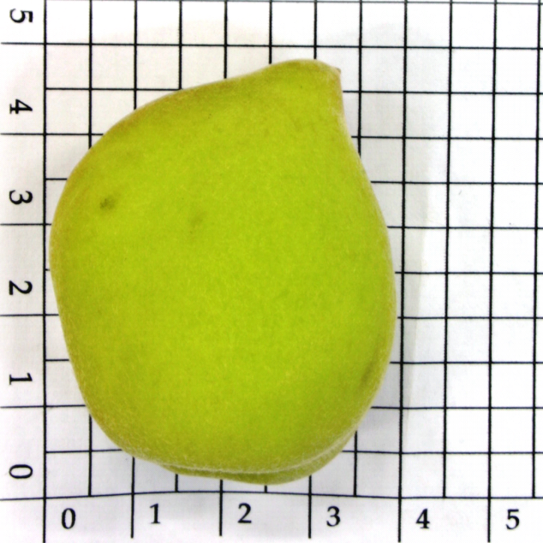
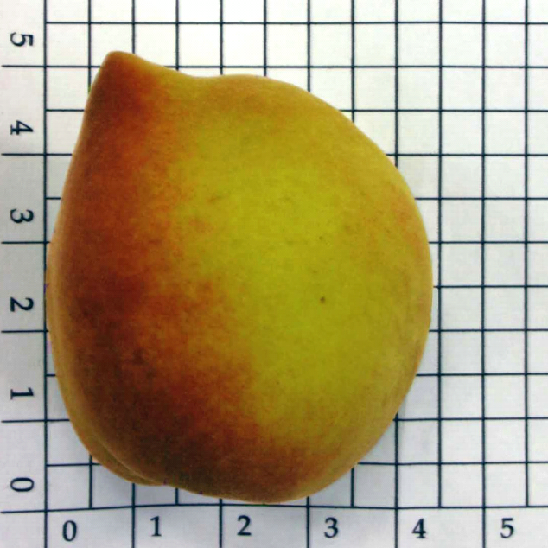
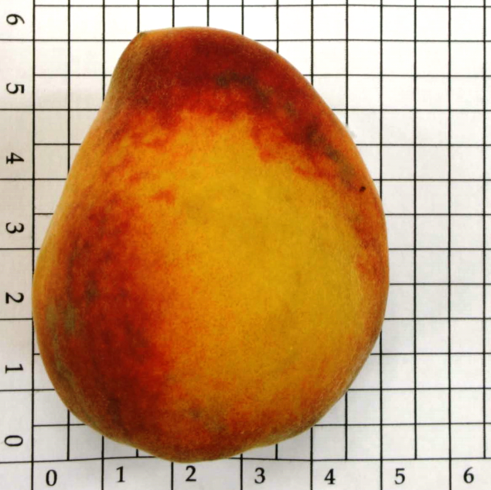
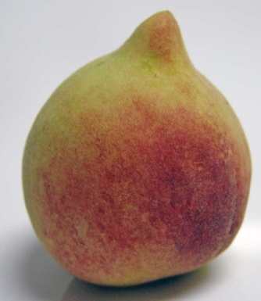


Soluble Solids Content and Firmness Determination In Intact Peach Fruit
cv. ‘Aurora 1' Using Near-Infrared Spectroscopy (NIR)
PALOMA A. M. NASCIMENTO¹, LÍVIA C. CARVALHO¹ , LUÍS C. CUNHA JÚNIOR² , GUSTAVO H.A. TEIXEIRA³
¹Universidade Estadual Paulista (UNESP), Faculdade de Ciências Farmacêuticas (FCF), Araraquara- SP – Brazil
² Universidade de São Paulo (USP), Faculdade de Ciências Farmacêuticas de Ribeirão Preto (FCFRP), Ribeirão Preto– SP – Brazil
³ Universidade Estadual Paulista (UNESP), Faculdade de Cîências Agrárias e Veterinárias (FCAV), Jaboticabal- SP, Brazil
FAPESP 2008/51408-1, 2012/00426-5 and 2014/04906-7
Aim
The objectives of this study was to develop a methodology using NIR spectroscopy for the quality control of intact ‘Aurora-1’ peach fruit for SSC and firmness, and verify the influence of maturity stage and harvest season on the models to be developed (robustness).
Data analysis
From the 490 intact fruits, 2 readings were conducted per fruit totalizing 980 NIR spectra. Spectra were handed using the software Unscrambler® X.1 (CAMO, Oslo, Norway). Principal component Analysis (PCA) was used to verify group formation and calibration was developed using Partial Least Squares (PLS) regression. Model performance was evaluated based on the values of root mean square error for prediction (RMSEP) and coefficient of determination (R2) obtained from different validation fruit samples, as such: i. full cross validation method, ii. test set of an independent dataset.
Results (2)
Background
The cultivar Aurora 1 is one of the most popular low chilling peaches in Brazil as the fruits have an attractive oblong shape, weight around 100 g, present a beautiful red skin color. It also has excellent sensory quality, with firm flesh, yellow pulp, and high soluble solids content (SSC ~14 °Brix), (Cunha Júnior et al., 2007).
The SSC in ripe peach has a variance from 9.6 to 15.8 °Brix, this difference is perceptive the human palate that has capacity to identify the fruit taste from 1 to 2 °Brix of difference (Walsh, 2009). According to Crisosto et al. (2003), the consumer preference for peach increased directly with the increase in SSC. In this regard, the classification of peach fruits by SSC is important for produce acceptance.
The current method for SSC determination is destructive and it does not allow to assess every unit of fruit in the packinghouse. On the other hand, the near infrared (NIR) spectroscopy is a non-destructive technique that has been used to assess the internal quality of fruits with good accuracy (Nicolaï et al., 2007). However, NIR spectroscopy has never been used in low chilling peach ‘Aurora 1’.
Results (1)
Table 1. Descriptive statistics (number of samples, mean, maximum, minimum and standard deviation) for the soluble solids content (SSC) of peach fruit ‘Aurora 1’.
Harvest | n | Mean (°Brix) | Max | Min | SD
1 | 360 | 12.0 | 17.6 | 7.4 | 1.6
2 | 360 | 10.7 | 16.5 | 7.1 | 1.4
3 | 260 | 10.9 | 14.7 | 6.3 | 1.7
Figure 5. Measured vs. predicted values of the soluble solids content (°Brix) of Aurora 1 peach based on NIR reflectance spectra. Average color.
Material and methods
Plant material: Peach (Prunus persica L. cv. Aurora 1) fruit were harvested at three maturity stages , as such: hue angle from the background skin colour <80° (Ripe, R); 80-100°(Mature, M); and >100° (Physiologically mature, PM), Fig. 1.
Figure 1. Peach fruits cv. Aurora 1 at three maturity stages.
Fruits were harvest in a commercial orchard located in Vista Alegre do Alto, São Paulo, Brazil, in three different periods during the harvest seasons in the 2013.
Spectra aquisition:
Diffuse reflectance spectra in the near infrared region (NIR) were acquired using a spectrophotometer Fourier transform FT-IR Spectrum 100N (PerkinElmer, Shelton, EUA). The spectra were collected on the background and blush color peel areas of the fruit (Fig. 2).
Figure 2. Background and blush color of peach fruits cv. Aurora 1.
Spectra were obtained as log 1/R and they were no pre-treated. The data were obtained in the range of the electromagnetic spectrum from 4,000 to 10,000 cm⁻¹, using 64 scans at a spectral resolution of 8 cm⁻¹.
Reference methods for soluble solids content (SSC):
The SSC was determined using the A.O.A.C reference method (920.151), (AOAC ,1997) by a digital refractometer ATAGO (Model PR-101α, Japan), expressed in °Brix.
Reference methods for firmness:
The firmness was determined using a penetrometer Bishop FT 327 with a 0.8 cm tip and the results expressed in Kgf.
Figure 6. Measured vs. predicted values of the firmness (KgF) of Aurora 1 peach based on NIR reflectance spectra. Background color.
Figure 3. Intact peach fruit ‘Aurora 1’ at three maturity stages raw spectra.
Conclusions / Future work
Although NIR spectroscopy can be successfully used to predict SSC and firmness of intact ‘Aurora-1’ peach fruit as a non-destructive method, more chemometrics is necessary to reduce RMSEP and improve calibration model prediction accuracy.
Background color
Blush color
Reference
A.O.A.C. Official methods of analysis of the Association of Official Analytical Chemists. 16.ed. Arlington: Ed. Patrícia Cuniff, 1997.
Crisoto, C.H., Crisoto, G., Bowerman, E. 2003. Searching for consumer satisfaction: new trends in the California peach industry. 1st Mediterranean Peach Symposium, Italy.
Cunha Júnior, L.C., Durigan, M.F.B., Mattiuz, B.H., Martins, R.N., Durigan, J.F. 2007. Caracterização da curva de maturação de pêssegos ‘Aurora-1’, na região de Jaboticabal-SP. Rev. Bras. Frutic. 29:3, 661-665.
Nicolaï, B.M., Beullens, K., Bobelyn, E., Peirs, A., Saeys, W., Theron, K.I., Lammertyn, J. 2007. Nondestructive measurements of fruit and vegetable quality by means of NIR spectroscopy: a review. Post. Biol. Technol. 46, 99-118.
Acknowledgments
Ripe
PM
Mature
Figure 4. PC1 vs. PC2 scores plot from PCA of NIR spectra of peach samples.

