Slide 1




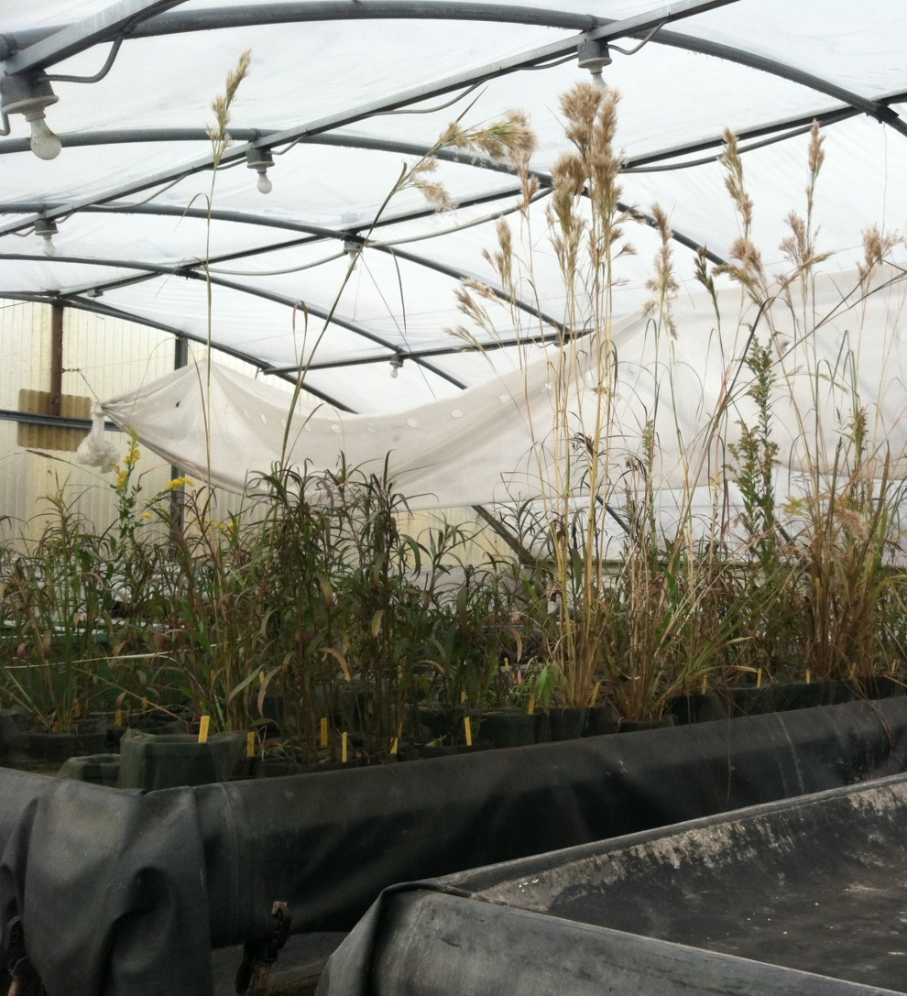
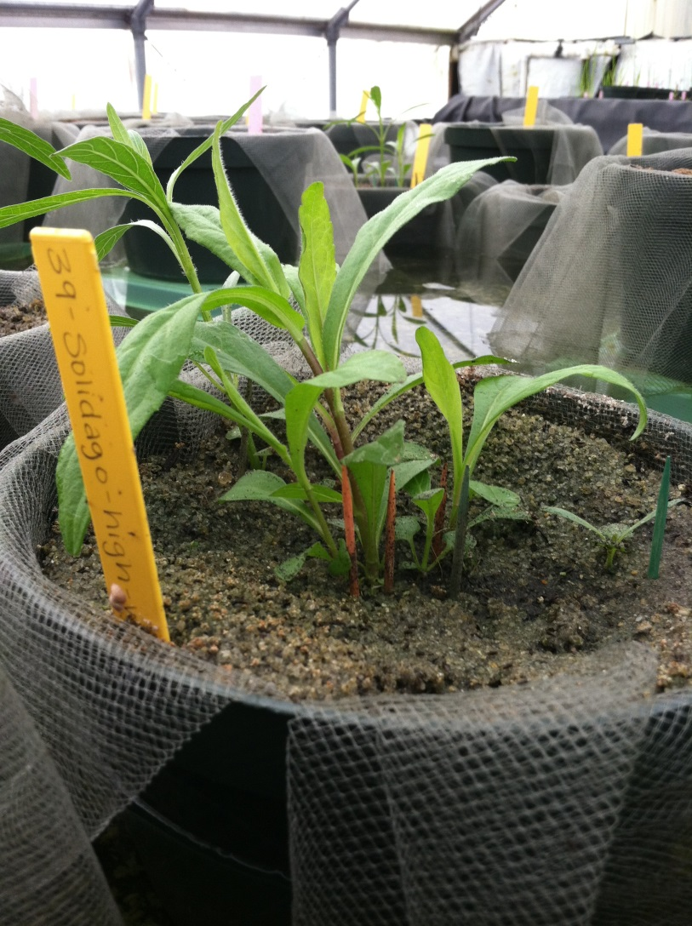
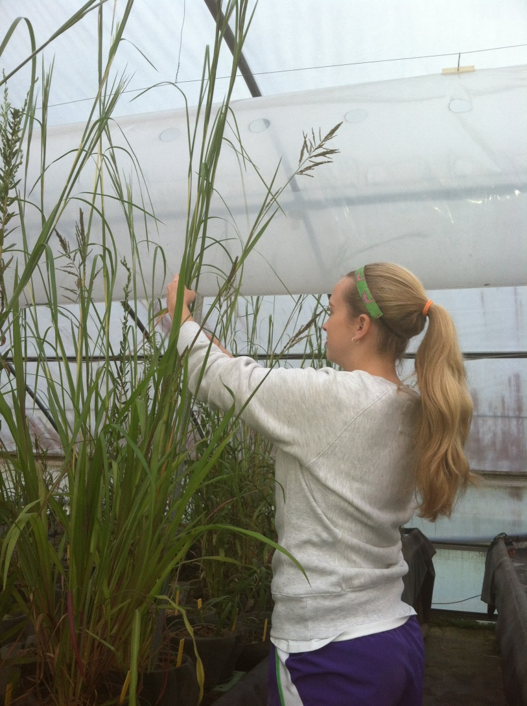
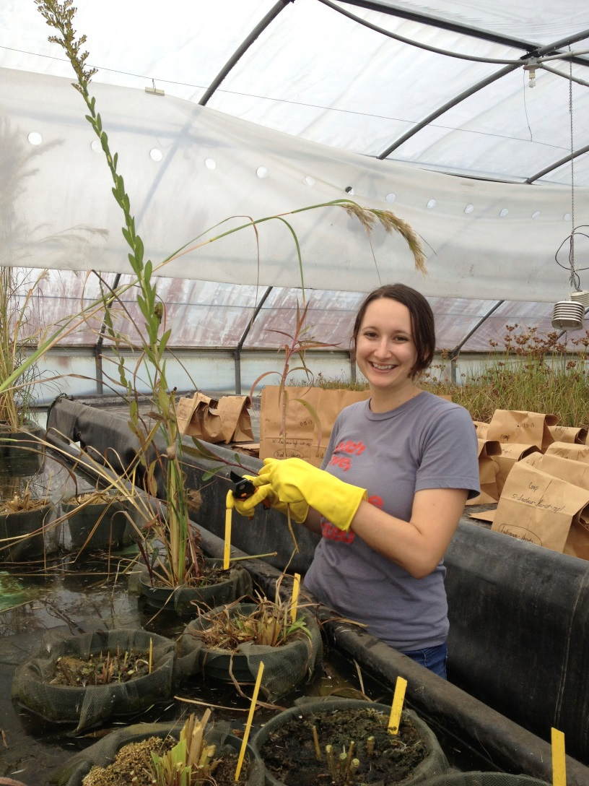
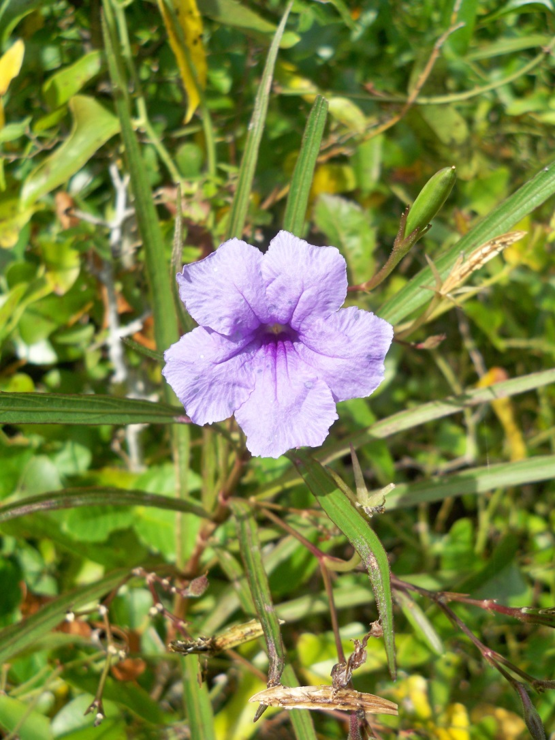
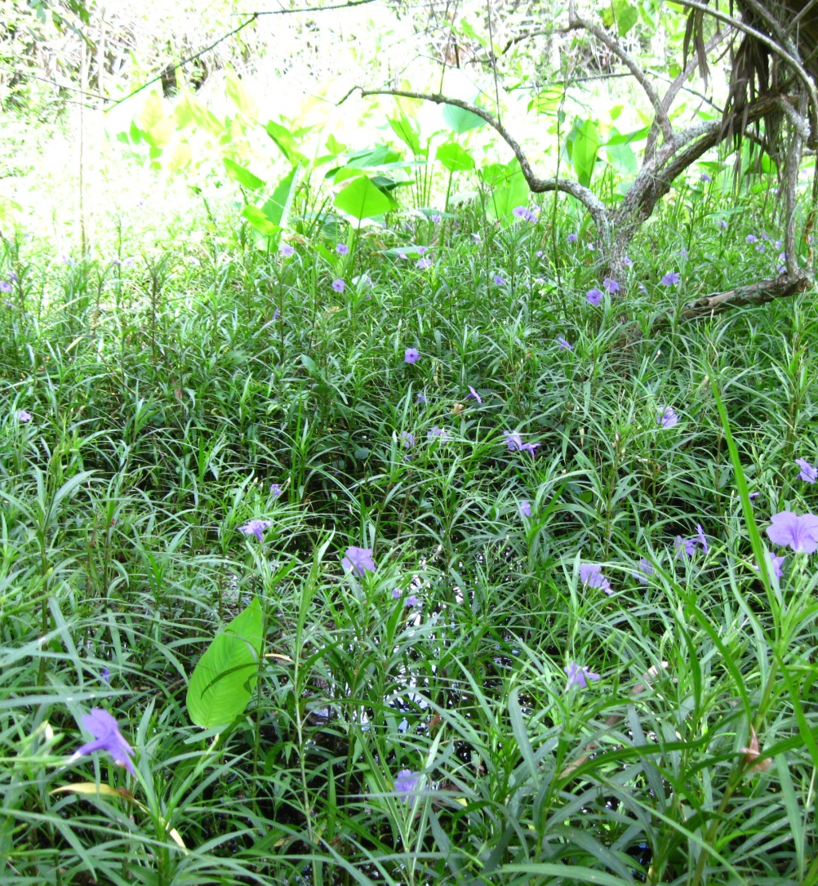
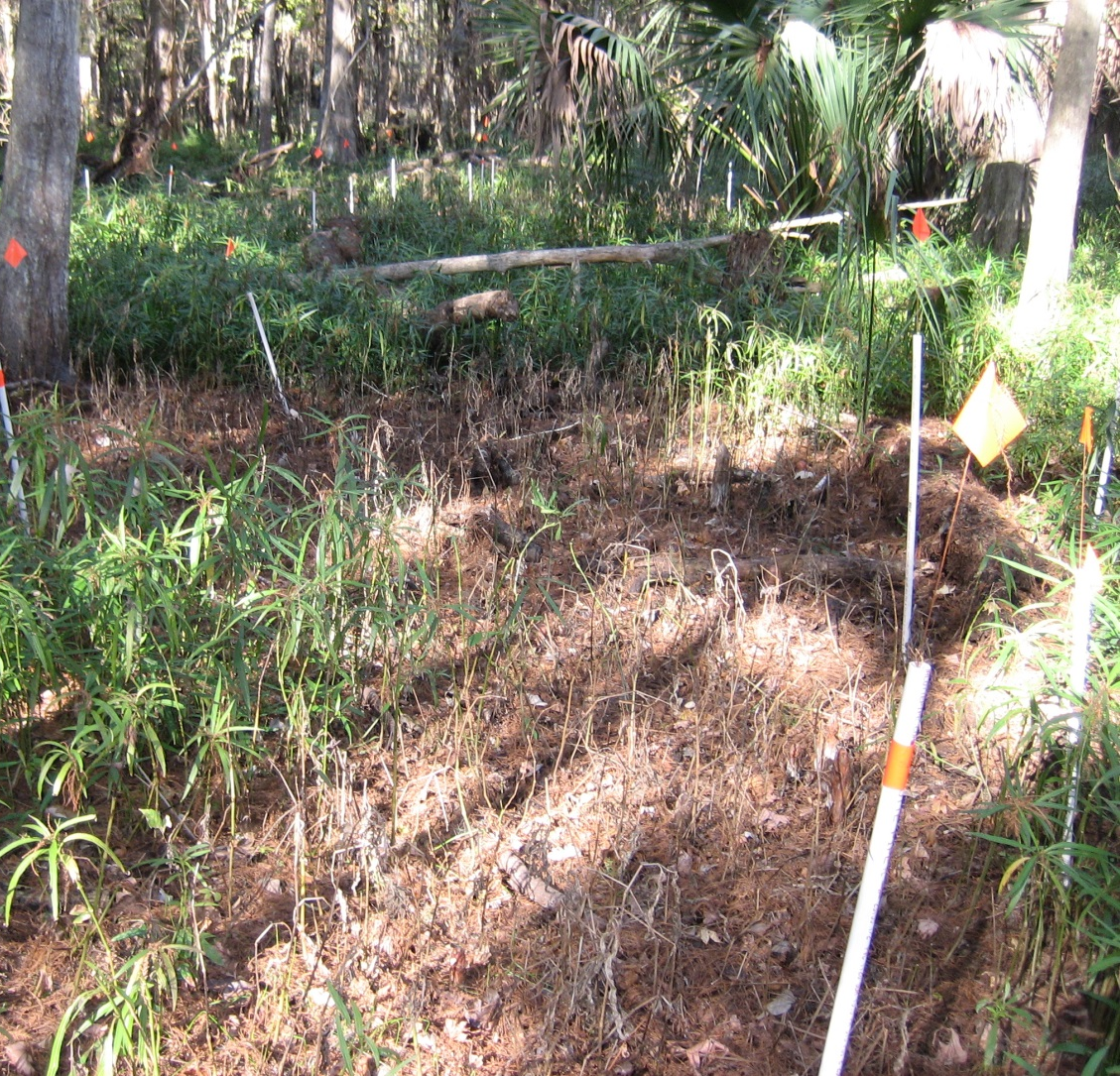
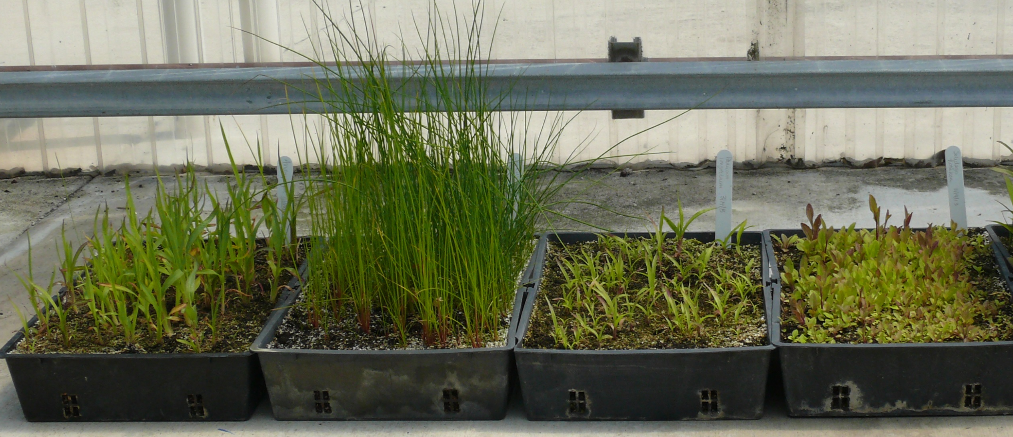
Management of an invasive ornamental: suppression of Ruellia simplex (Mexican petunia) by native species during initial establishment from seed
Adrienne M. Smith, Carrie Reinhardt Adams, Sandra B. Wilson, Christine Wiese
Department of Environmental Horticulture, University of Florida
Introduction
Ruellia simplex (Mexican petunia) was introduced for ornamental use in the 1940s from Mexico (Wunderlin and Hansen 2014). Since then it has escaped cultivation, invaded natural areas, and is now listed as a Florida Exotic Pest Plant Council Category I invasive species for displacing native plant communities (FLEPPC 2013). The UF/IFAS Assessment does not recommend its use in Florida (updated 2013). Initial short-term control is effective (Reinhardt-Adams et al. 2014, Figure 1), yet lack of natural recolonization of natives and heightened propagule pressure from surrounding urban landscapes predisposes reinvasion. Revegetation with native species well-matched to current degraded conditions may promote native species establishment and limit reinvasion. We examined initial competition with R. simplex during revegetation with select native floodplain species: Andropogon glomeratus (bushy bluestem), Juncus effusus (soft rush), Panicum longifolium (redtop panicgrass), and Solidago fistulosa (pinebarren goldenrod) (Figure 2).
a
A
B
C
D
Figure 3: A) Pots were filled with a 1:3 ratio of Fafard 2 and coarse sand mix seeded with designated species compositions and placed under different hydrologic conditions in a ponded bench; B) Seedling establishment (i.e. first true leaf, marked with toothpick) and survival were collected weekly for 24 weeks; C) Shoot height was collected biweekly for 24 weeks; D) Aboveground and belowground biomass were collected at the conclusion of the study at week 24.
b
R. simplex alone - saturated
J. effusus + R. simplex – saturated – low
Table 1: Mean number of R. simplex individuals (survival) in native species composition treatments, native species densities, and water levels at 24 wks. Treatments are separated by a horizontal line. Means within each treatment grouping followed by the same letter were not significantly different (α = 0.05).
J. effusus + R. simplex – saturated – high
S. fistulosa + R. simplex – saturated – low
S. fistulosa + R. simplex – saturated – high
broad mix + R. simplex – saturated – low
broad mix + R. simplex – saturated – high
R. simplex alone – unsaturated
Treatment | Number of R. simplex individuals | SE
R. simplex alone
saturated | 6.11 a | 0.51
unsaturated | 0.29 b | 0.24
J. effusus + R. simplex
saturated – low | 5.63 a | 0.80
saturated – high | 6.55 a | 1.01
unsaturated – low | 0.60 b | 0.58
unsaturated – high | 0.33 b | 0.24
S. fistulosa + R. simplex
saturated – low | 2.38 b | 0.60
saturated – high | 4.58 a | 0.37
unsaturated – low | 0.63 c | 0.40
unsaturated – high | 0.55 c | 0.37
broad mix + R. simplex
saturated – low | 4.92 a | 0.51
saturated – high | 2.15 b | 0.87
unsaturated – low | 0.48 bc | 0.24
unsaturated – high | 0 c | 0
J. effusus + R. simplex – unsaturated – low
J. effusus + R. simplex – unsaturated – high
S. fistulosa + R. simplex – unsaturated – low
S. fistulosa + R. simplex – unsaturated – high
A
B
C
broad mix + R. simplex – unsaturated – low
broad mix + R. simplex – unsaturated – high
Figure 1: A) Mexican petunia is a commonly planted ornamental recognizable by its purple flowers and explosive seed capsules; B) Propagules disperse into floodplains creating dense invasions; C) Chemical control is effective but natural recolonization alone does not restore the native plant community and protect from reinvasion.
Figure 5: Mean shoot height (cm) of R. simplex grown in each treatment for 24 weeks under saturated and unsaturated soil conditions and low and high native species seeding densities. Means with the same letter were not significantly different (α = 0.05).
Conclusions
Native species can suppress R. simplex: Ruellia simplex, S. fistulosa, and A. glomeratus (part of the broad mix) established 2 – 5 weeks after sowing. A reduction in number of R. simplex individuals may be attributed to limitation of R. simplex germination by S. fistulosa and A. glomeratus despite low germination. Ruellia simplex biomass decreased when planted with rapidly establishing, functionally diverse natives (i.e. broad mix). Shoot height of R. simplex was not reduced.
Target invasions in low elevations: Ruellia simplex had higher germination and establishment in saturated conditions, confirming R. simplex preference for low elevations (Hupp 2007).
Use higher native seeding densities: High native seed density suppression of R. simplex was similar to suppression by low native seed density (used in revegetation scenarios), suggesting that doubling the seeding density did not additionally suppress R. simplex. This commonly used density may be too low or germination may be insufficient.
Best revegetation approach: Solidago fistulosa and a broad native mix suppressed R. simplex in our experiment. To further develop recommendations to managers, we are testing these revegetation strategies in a formerly-invaded floodplain wetland in Florida.
Methods
The study consisted of a 2×2×3 replacement design with two hydrologic regimes (saturated and unsaturated soil conditions), two native seeding densities (low and high), and three native compositions (J. effusus + R. simplex, S. fistulosa + R. simplex, and a broad mix of natives + R. simplex). Seeding densities were chosen to mimic typical revegetation seeding practices. Pots were seeded with designated treatment combinations, each with five replicates, and placed in a ponded bench in a plastic-sided polyhouse in May 2013. Seedling establishment, survival, shoot height, and biomass were collected (Figure 3).
ab
a
A
B
C
D
b
bc
Acknowledgements
Technical assistance was provided by Leah Cobb Lee and Candice Prince. Peter Henn (St. Johns River Water Management District) permitted collection of R. simplex seed. Mark Fiely (Ernst Conservation Seeds) donated seed. Financial support was provided by the Florida Fish and Wildlife Conservation Commission Invasive Plant Management Section Student Minigrant and the FLEPPC Julia Morton Invasive Plant Research Program.
Figure 2: Native floodplain species used in this study are A) Andropogon glomeratus, B) Juncus effusus,
C) Panicum longifolium, and D) Solidago fistulosa.
Results
Native species can suppress R. simplex despite low germination: While only 25% and 15% of S. fistulosa and A. glomeratus seeds germinated respectively, these species reduced R. simplex survival (Table 1) and total biomass (Figure 4). Natives did not suppress R. simplex shoot height (Figure 5). Juncus effusus and P. longifolium had surprisingly low germination (both <1%), and did not suppress R. simplex. All natives did not germinate as anticipated.
Native species and R. simplex have similar establishment timing: Ruellia simplex, A. glomeratus, and S. fistulosa seedlings established within a 2-5 week period. Juncus effusus and P. longifoilum seedlings established in a 2-6 week period.
R. simplex alone
J. effusus + R. simplex
broad mix + R. simplex
Literature Cited
Florida Exotic Pest Plant Council (FLEPPC). 2013. List of invasive plant species. http://www.fleppc.org/list/2013PlantList_HiRes.pdf
Hupp, K.V.S. 2007. Investigating the determinants of local scale distribution of Ruellia tweediana (synonym R. brittoniana) in natural areas. Gainesville, Florida. M.S. Thesis. University of Florida.
Reinhardt-Adams, C., C. Wiese and L.C. Cobb. 2014. Effect of season and number of glyphosate applications on control of invasive Ruellia simplex. Ecological Restoration. In press.
Wunderlin, R.P. and B.F. Hansen. 2014. Atlas of Florida vascular plants. http://www.plantatlas.usf.edu
S. fistulosa + R. simplex
Figure 4: Mean R. simplex total (aboveground + belowground) biomass (g) in each treatment at the end of 24 weeks under saturated and unsaturated soil conditions and low and high native species seeding densities. Means with the same letter were not significantly different (α = 0.05).

