Slide 1
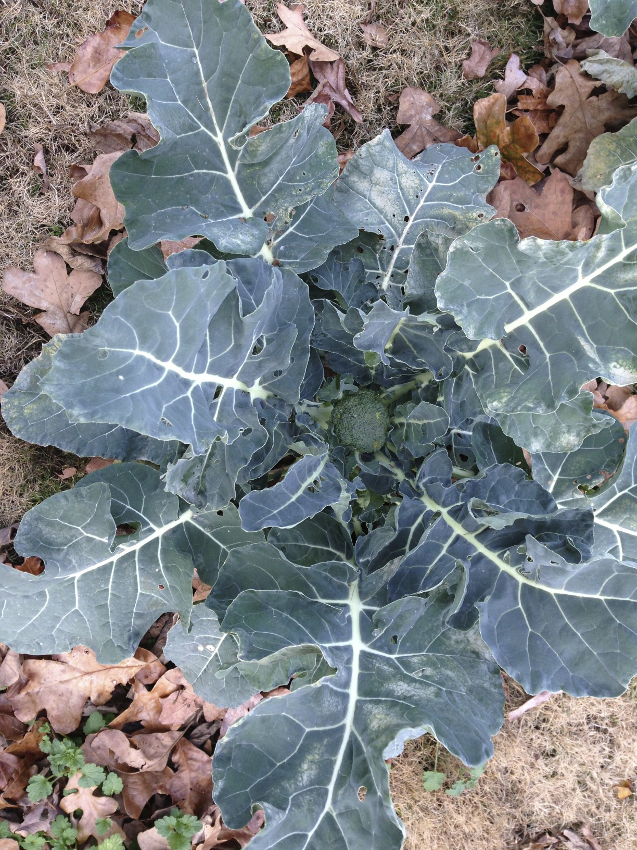

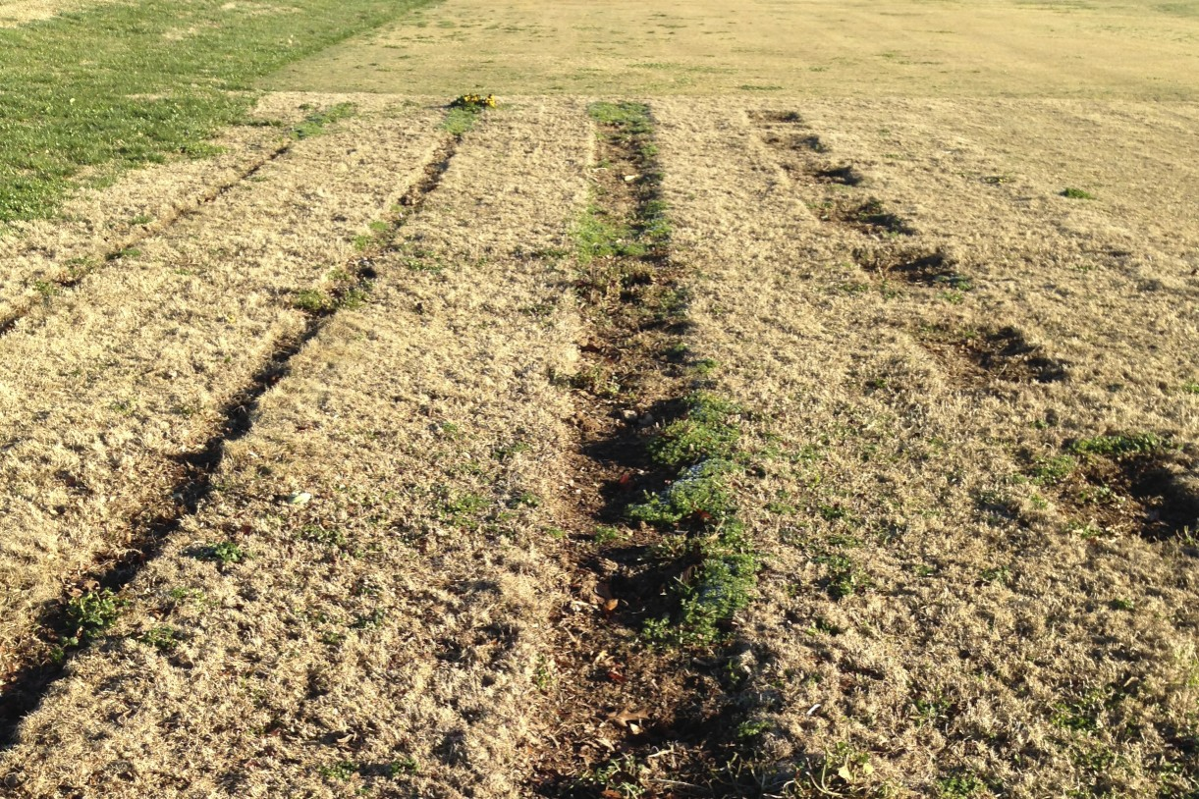
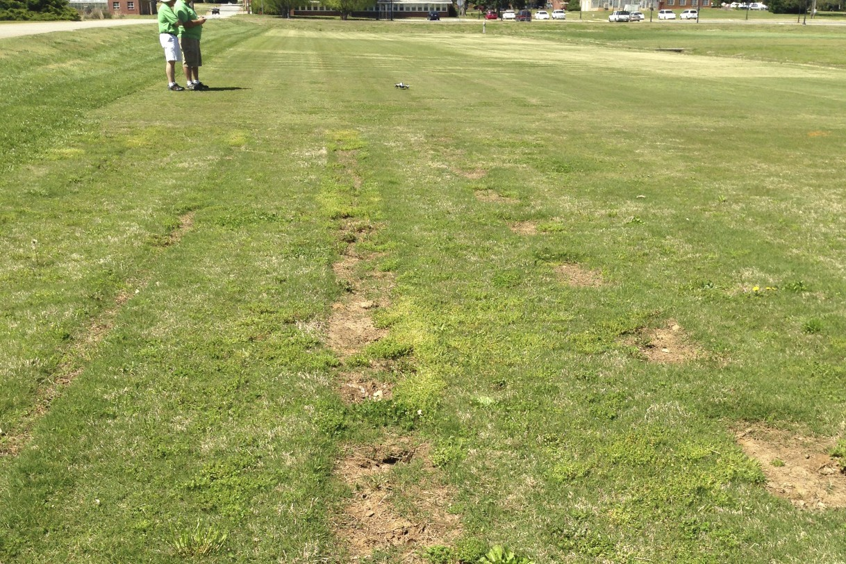
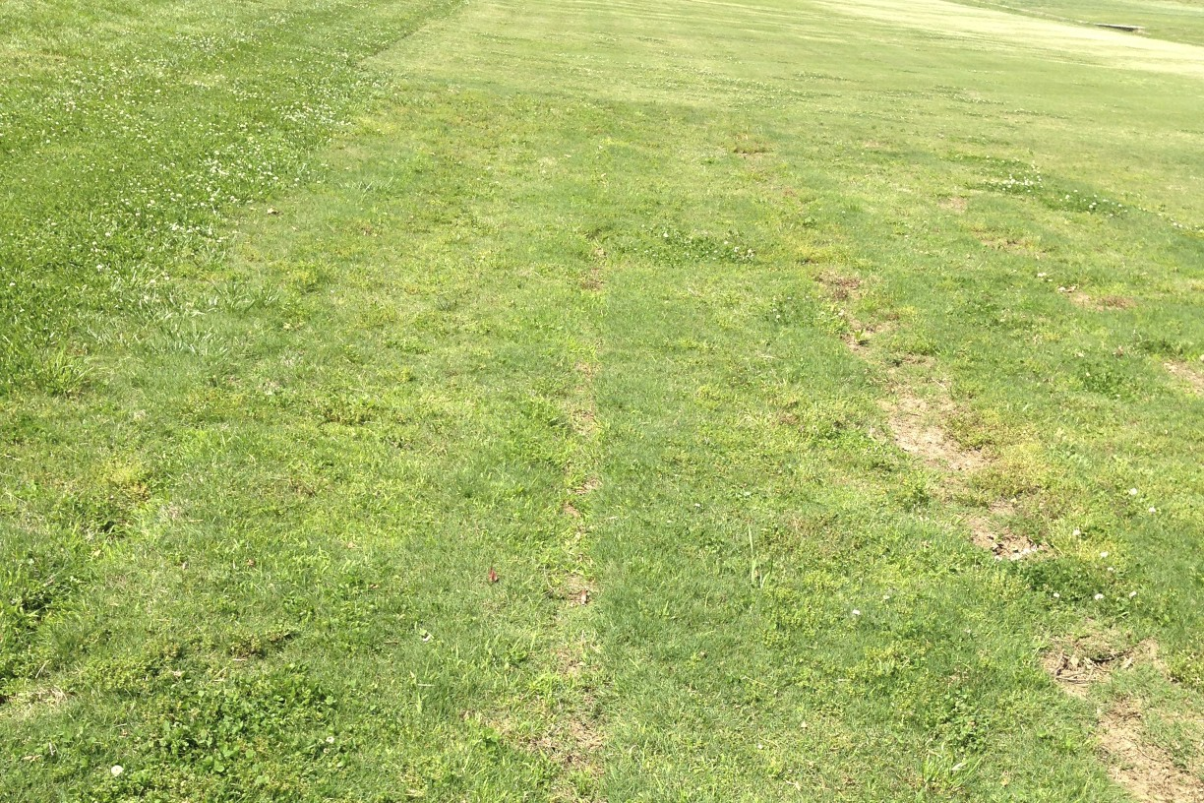
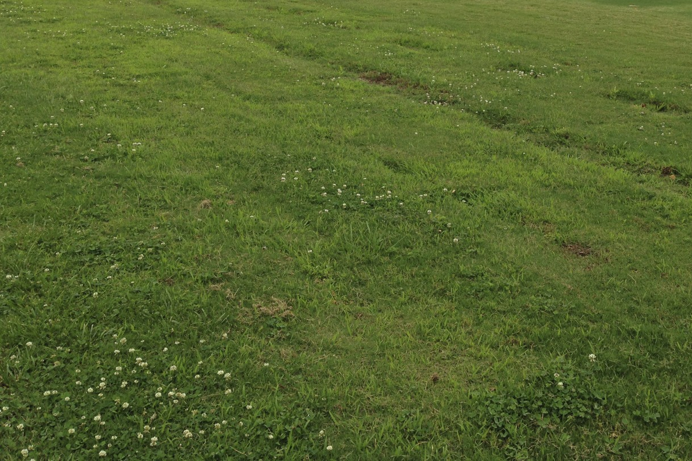
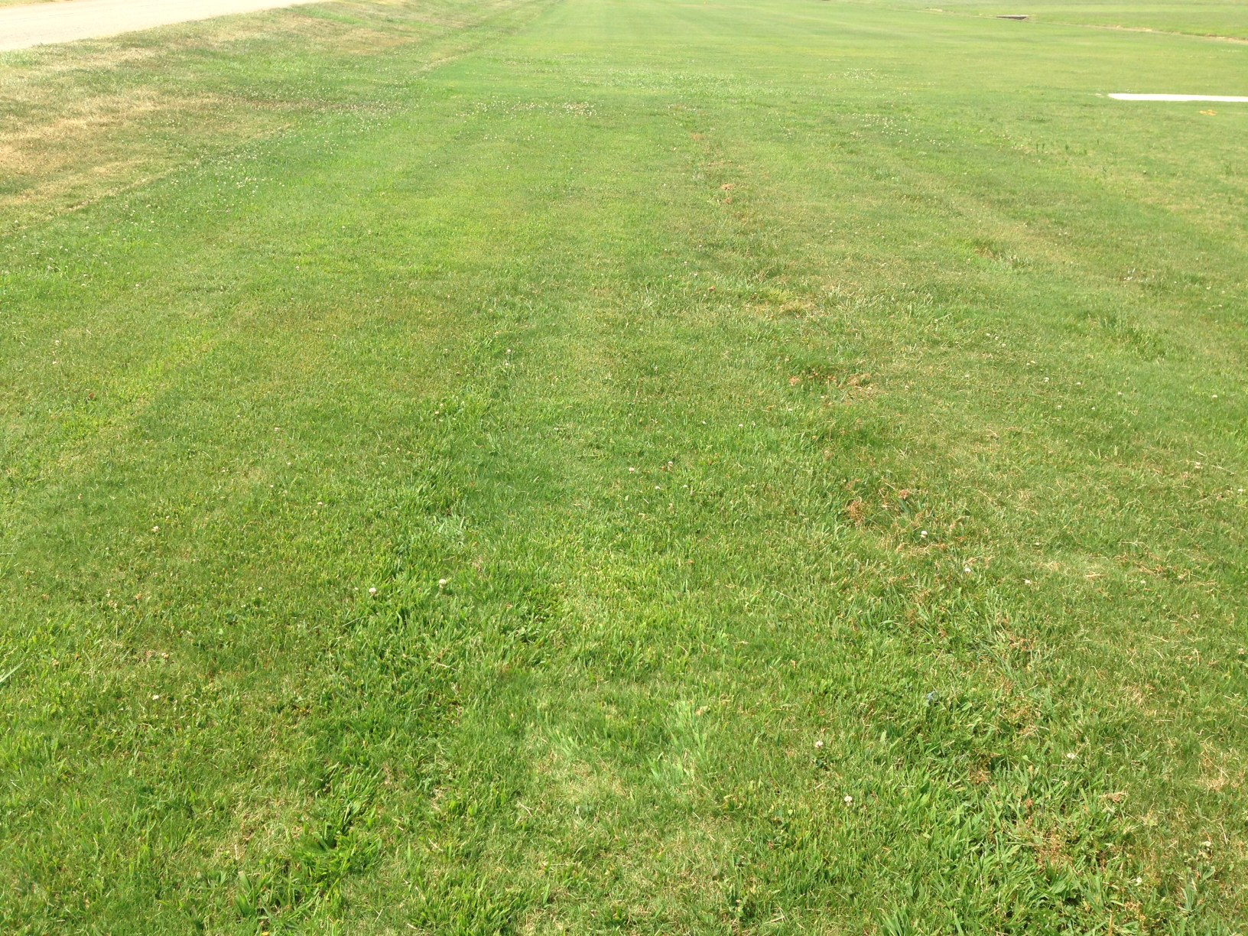
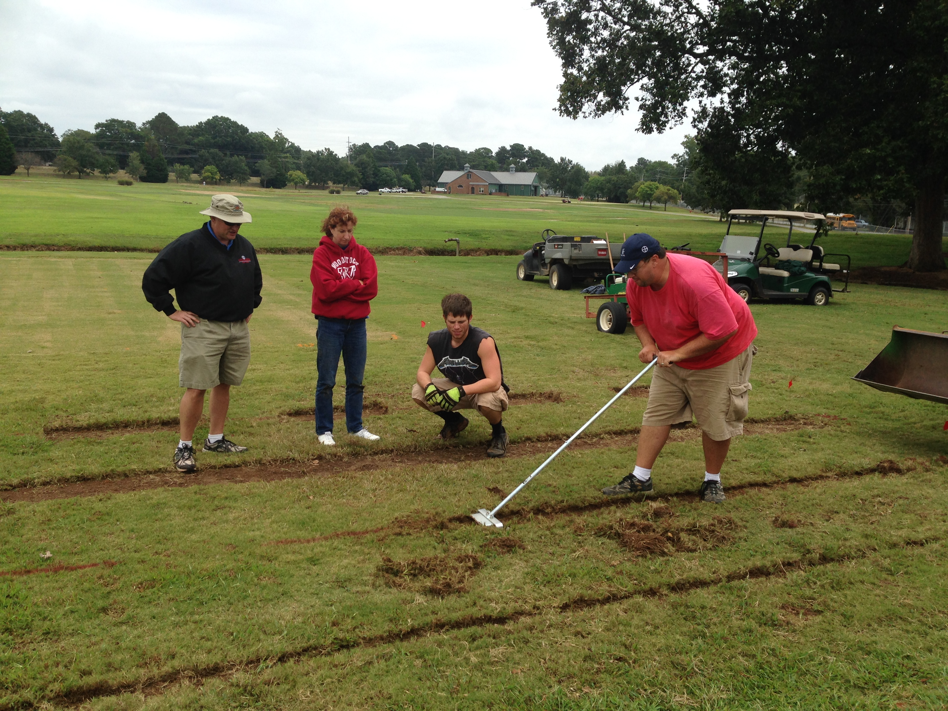
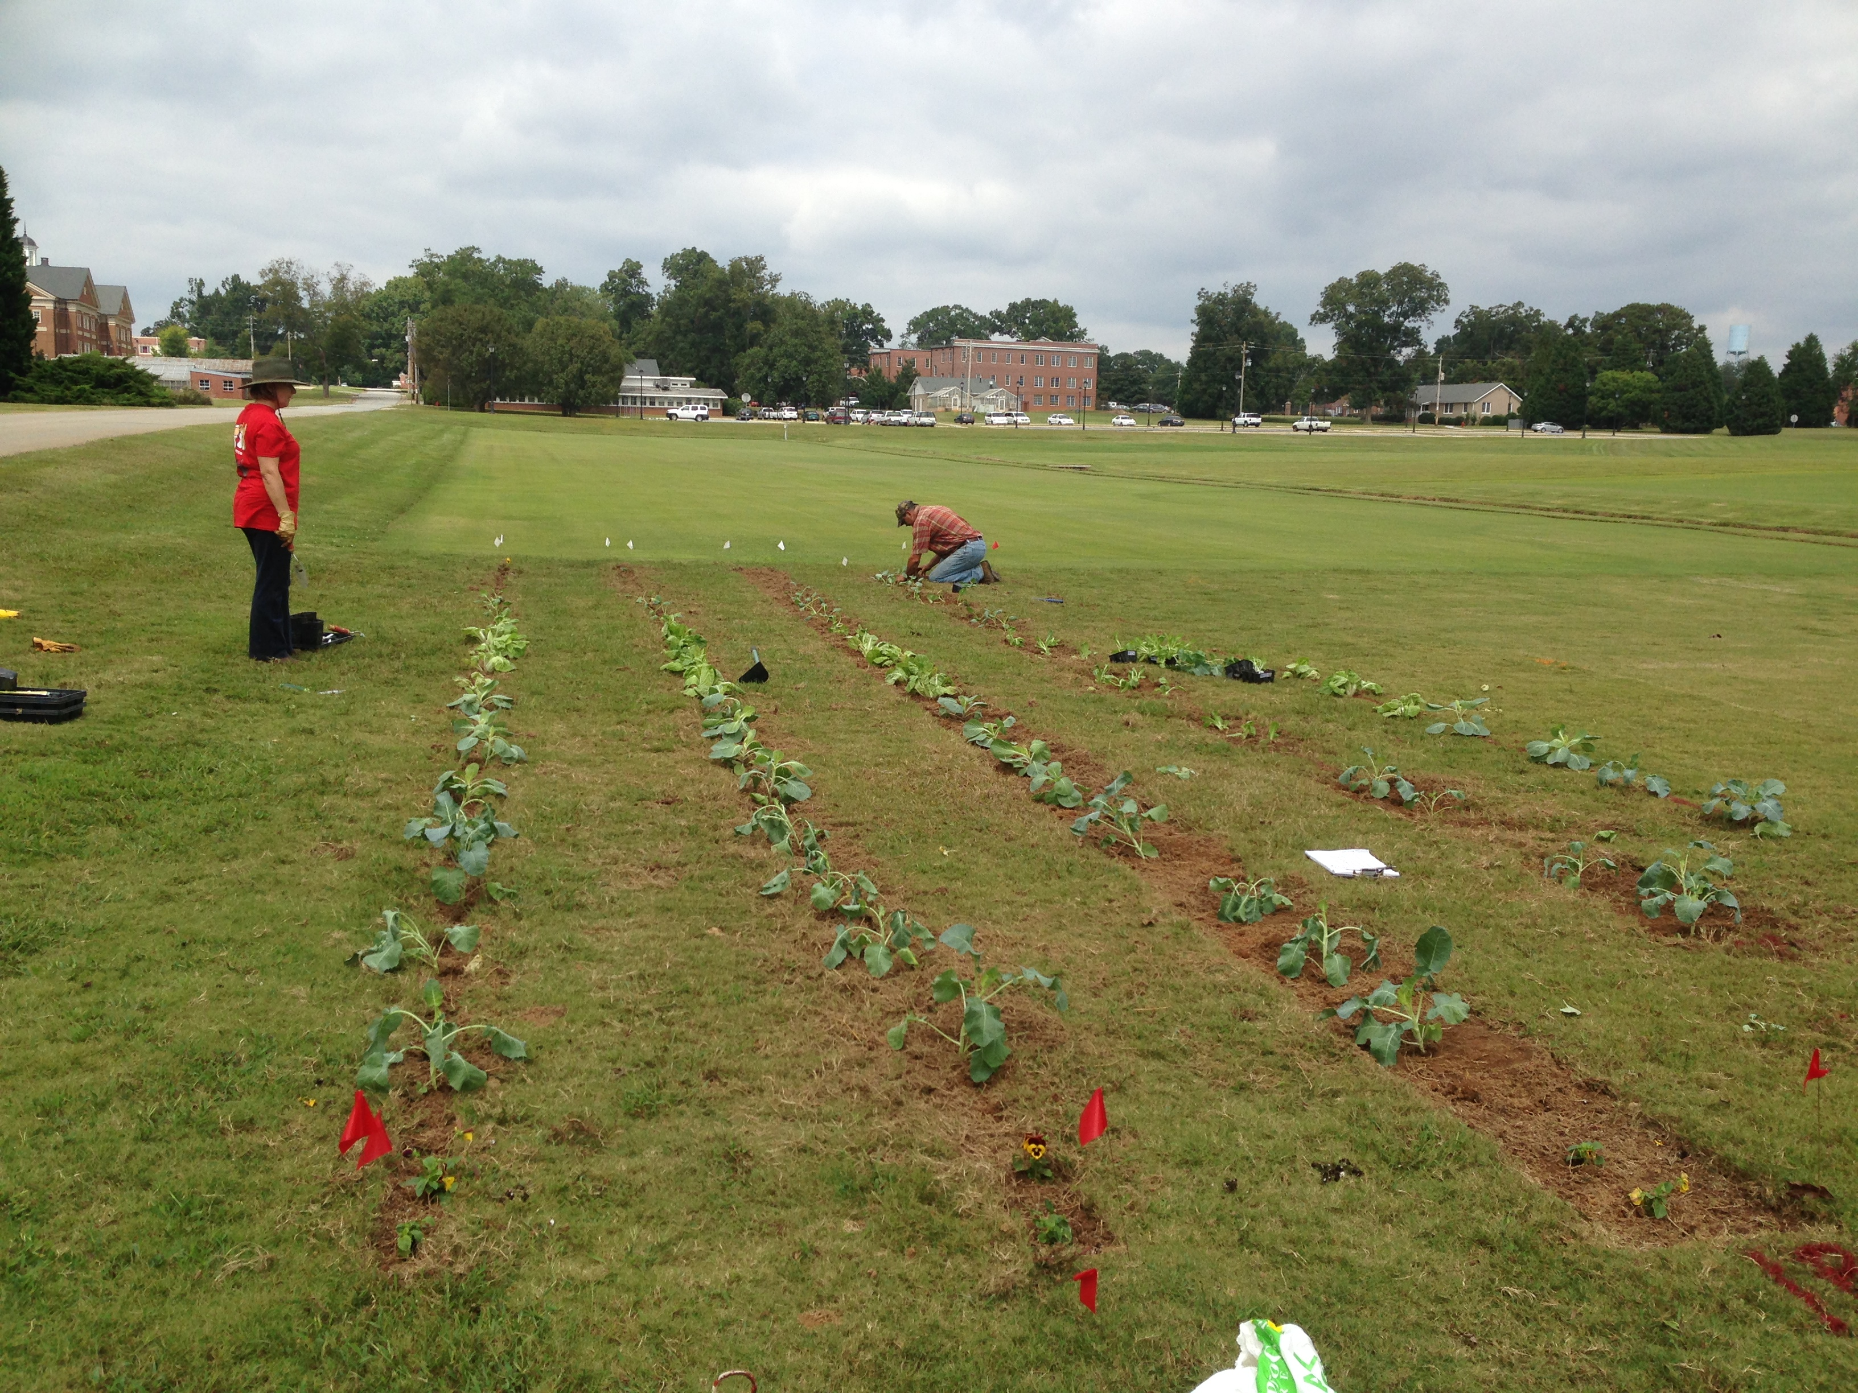
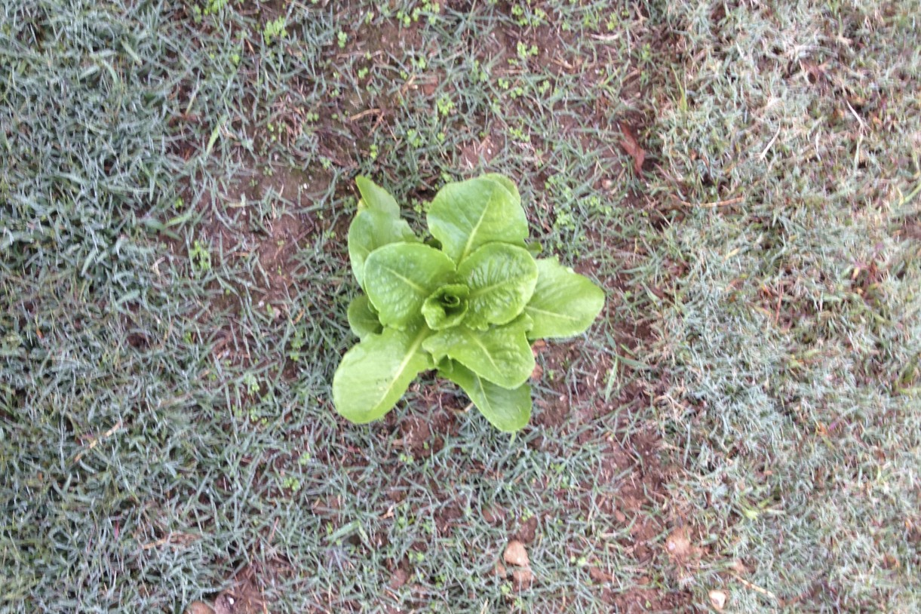
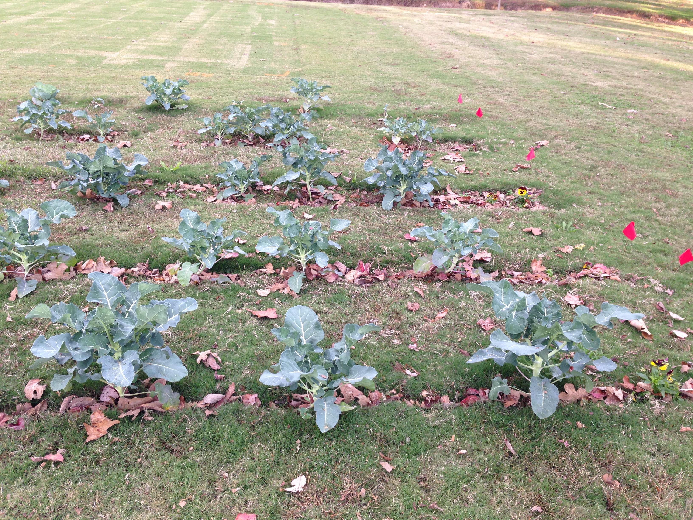
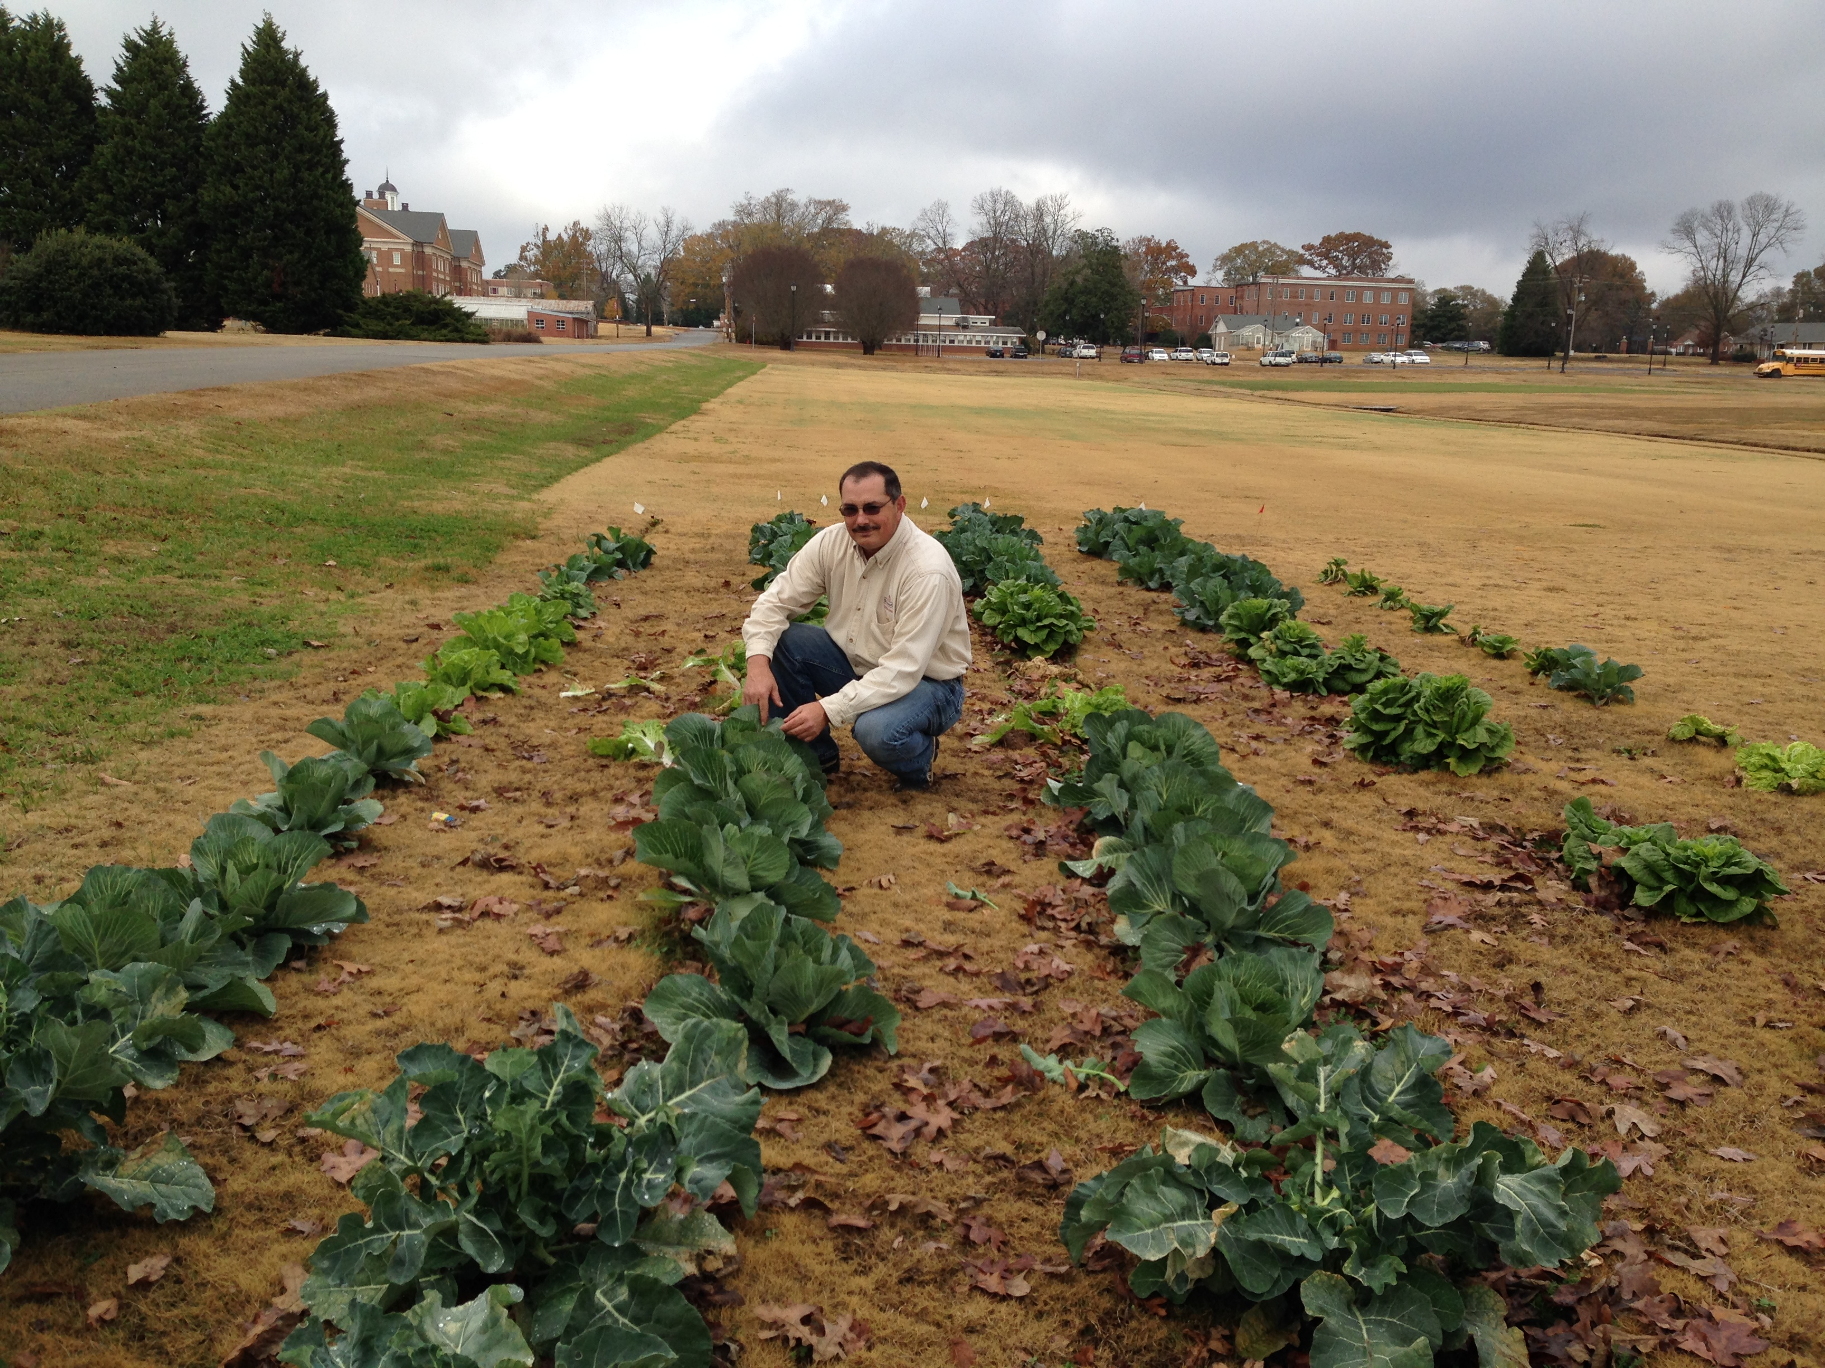
Lunch and Lawn: Can You Have Grass and Eat Too?
E. M. Bauske¹, F. C. Waltz Jr.² and R. Westerfield³
¹Georgia Center for Urban Agriculture, University of Georgia; ²Dept. of Crop and Soil Science, University of Georgia; and ³Dept. of Horticulture, University of Georgia.
March 12, 2014
April 23, 2014
May 7, 2014
June 3, 2014
July 7, 2014
ABSTRACT
To explore the possibility of using the same space for a fall vegetable garden and a warm-season summer lawn, Top Bunch Hybrid collards, Sweet Surprise cabbage, Kaboko cabbage, Pacman Hybrid broccoli (Brassica sp.) and Butter Crunch lettuce, (Lactuca sativa) were planted into a hybrid bermudagrass lawn in late September. Strips or rows measuring 13 cm, 18 cm and 46 cm wide and plots, measuring 46 x 91 cm were cut into the lawn. Lettuce, collards and cabbage were successfully produced in the 18 cm wide strip or row, 46 cm row and the 46 x 91 cm plots. Lettuce, collards and cabbage were not successful in the 13 cm row or when directly planted into turfgrass. Broccoli produced edible florets in all treatments. At the first evaluation of the bermudagrass lawn, made in mid-March, the lawn covered 95% of the bare soil in the direct-planted strip and 40% of the bare soil in the 13 cm strip. By June the lawn covered the 13 cm strip, but a furrow remained, creating a slightly uneven surface. The 18 cm strip was largely covered with turf by early June, but it was both uneven and unsightly. The 46 cm strip and 46 x 91 cm plots did not exceed 75% coverage by early June and were very uneven. Crabgrass was present in all but the direct-planted row.
MATERIALS AND METHOD
In late September, 2013 sod cutters were used to cut 12 m strips, which were 13 cm, 18 cm, and 46 cm wide, into a hybrid bermudagrass lawn. Four plants each of Top Bunch Hybrid collards, Sweet Surprise cabbage, Kaboko cabbage, Pacman Hybrid broccoli (Brassica sp.) and Butter Crunch lettuce (Lactuca sativa) were planted into the strips (broccoli and cabbages, 60 cm apart; lettuce, 15 cm apart, and collards, 30 cm apart). Lettuce, collards and broccoli were also planted in 46 x 91 cm plots separated from each other by 60 cm. All cultivars were also planted directly into turfgrass (60 cm apart). Plants were fertilized with 10-10-10 individually at the rate of 50 g/m² at planting and again at four weeks. Field observations were made through early December on general plant health and yield. Field observations of lawn recovery were made March through June, 2014. Vegetables were treated with insecticidal soap as needed to control aphids. No herbicides were applied to the lawn in the spring.
RESULTS
Collards, cabbage and lettuce grown in the 13 cm strip and directly planted into the turfgrass did not thrive. Plants were visibly stunted and produced little harvestable yield. In contrast, all four broccoli plants produced edible florets in the 13 cm strip and two produced edible florets in the direct planted row.
Lettuce and collards did well in 18 and 46 cm strips and in the 46 x 91 cm plots, producing harvestable yield. Broccoli also preformed well in these treatments. Only three Kaboko cabbages were harvested in the study (one in the 13 cm strip and two in the 18 cm strip) and no Sweet Surprise cabbages were harvested as the growing season was not long enough for this cabbage.
In early March, vegetable remains were removed by hand as the collards became entangled in the mower blades. Pulling plants left holes created by the root balls in the strips and plots. Though the bermudagrass was largely dormant at the first evaluation made in mid-March, it had covered 95% of the bare soil in the direct-planted row and the 13 cm strip was 40% covered (Fig.1). By June the lawn covered the 13 cm strip, but a furrow remained, creating a slightly uneven surface. The 18 cm strip was largely covered with turf by early June, but it was both uneven and unsightly. The 18 cm strip and plots did not exceed 75% coverage by early June and were very uneven. Crabgrass was present in all but the direct-planted row.
Several observations were made in the course of this demonstration that will inform future studies.
Caution must be exercised using chemicals on lawns and vegetables. All pesticides should be used only as recommended on labeled crops.
The manual sod cutter used to create the 13 and 18 cm strips was designed for use on golf putting greens and was extremely difficult to push through the lawn in this study.
As leaves fell from trees they lodged in the strips, creating natural mulch for the vegetables.
Irrigation must be maintained on the lawn after the turfgrass is dormant and automated systems must be adjusted accordingly.
INTRODUCTION
Enthusiasm for local food production, self-sufficiency and food safety has generated increased interest in home vegetable gardens. However, many urban dwellers have small outdoor spaces and often lawns occupy the only full sun areas of the landscape.
Lawns can be replaced with food gardens. This approach has many supporters (Hadden, 2012 and Haeg, 2010). However, many people enjoy their lawns and the many physical and psychological benefits they provide (Bauske &Waltz, 2013 and Beard & Green, 1994).
If one can tolerate a slightly weedy lawn, several lawn weeds commonly found in Georgia can be eaten (Fern, 2000). These include wild garlic (Allium oleraceum), white clover (Trifolium repens), dandelions (Taraxacum officinale), yarrow (Achillea millefolium), lawn daisies (Bellis perennis), chicory (Cichorium intybus), cat’s ear (Hypochoeris radicata), plantains (Plantago sp.) and coltsfoot (Tussilago farfara).
This demonstration explored the possibility of enjoying both a summer lawn and a winter vegetable garden. The prospect of double-cropping a warm-season lawn with winter vegetables was examined in an informal study in Griffin, GA. The objective of this project was to determine if fall vegetables could be grown in a dormant lawn producing both vegetables and a satisfactory summer lawn.
CONCLUSIONS
Though none of the cultivation techniques were entirely satisfactory, this demonstration suggests it may be possible to double-crop a lawn with winter vegetables and suggests several options for future study. Direct planting resulted in marginal vegetable production, but the lawn recovered the quickest. The other techniques were either too difficult to implement (13 cm and 18 cm strips) or resulted in unsightly and uneven summer turfgrass. Uneven turfgrass can be a safety hazard as people play, walk, and run across the lawn.
Other techniques to prepare the lawn for fall vegetable gardening should be explored. Glyphosate may prove to be a useful tool for turfgrass preparation. The relative success of the broccoli also indicates that some vegetables may preform better than others in a lawn environment. The potential of other vegetables and turfgrass cultivars should be explored. Finally, the use of pre-emergence herbicides for spring crabgrass control should be considered.
REFERENCES
Bauske, E. M. and C. Waltz. 2013. Influence of turfgrass on human aesthetics and psychology: a review. Acta Hort. (ISHS) 888:37-41.
Beard, J.B. and R. L. Green. 1994. The role of turfgrasses in environmental protection and their benefits to humans. J. Environ. Qual. 23:452-460.
Hadden, 2012. Beautiful No-mow Yards. Timber Press, Inc. Portland, OR.
Haeg, F. 2010. Edible Estates Attack on the Front Lawn. Metropolis Books. New York, NY.
Fern 2000. Plants for a Future, Edible & Useful Plants for a Healthier World. Chelsea Green Publishing Co. White River Junction, VT.
Sept. 24, 2013
Sept. 25, 2013
Oct. 14, 2013
Oct. 28, 2013
Dec. 2, 2013

